Slide 1
Are you being Cyberbullied?
You have a responsibility to protect yourself from danger and to help others who are in trouble.

Slide 2
What is Cyberbullying?
Cyberbullying is the use of technology to harass, threaten, embarrass, or target another person.

Slide 3
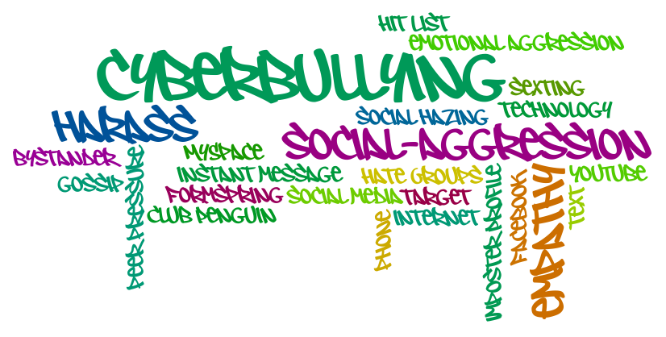

Slide 4
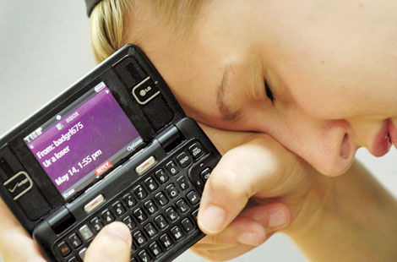
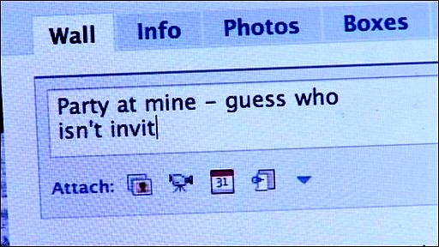
Identifying Online Threats:
Someone is using Inappropriate language
Someone is threatening you or insults you..(text, gaming, Instagram, Ask, etc.)
People send repeated messages (text bombing, etc)
People can steal your passwords and hack into your accounts
People can steal your identity
Sexual Predators: People can pretend to be a certain age to gather information and “groom” young teens
People can post mean messages or photos of you
Spam (unsolicited email sent from someone receiver does not know). This can also give viruses to your computer.

Slide 5
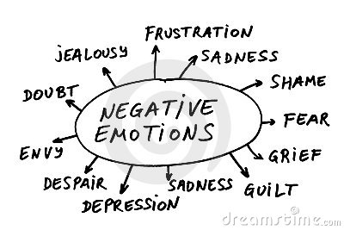
How does a person feel who is being cyberbullied?
Upset/Angry
Dip in energy level
Sleep disturbances
Appetite disturbances
Jumpy/ Agitated
Anxious/Moody
Sad
Remember…cyberbullying can happen @ school & home (24 hours/day). People can become worried or anxious because __________________________________.

Slide 6
Ways to prevent cyberbullying and stay safe online:
Full name
Home address
Phone number
Social security number
Passwords
Names of family members
Credit card numbers
Name of school/teachers
Mother’s maiden name
Never give out personally identifiable information online. This includes, but is not limited to:
However, some personal information is OK
to put online. However, be sure that the information you put out there does not reveal your identity.

Slide 7
More ways to prevent Cyberbullying: (Cont.)
2. Never tell anyone but your parents your passwords.
3. If someone sends a mean or threatening message, don’t respond. (You should save it or print it out & show an adult!)
4. Don’t put anything online that you wouldn’t want your classmates or parents to see.
5. Don’t send messages when you are angry.
6. Don’t join in when someone is being cyberbullied.
7. Think of the golden rule! Think about how you would feel if someone posted something or said something negative or hurtful about YOU!
8. Never agree to meet in public without telling your parents first. If you do meet, meet with an adult and in a public place..ie, Marketplace Mall.

Slide 8
AHH…the Internet
The internet is a whole network of computer networks that share information with each other. It is also known as the “Information Super Highway.”
Anybody can use the internet and there are no special rules or classes a person must take before they can use the Internet. This is why it is so important to know the safety precautions so you keep yourself safe.
In school you use the Internet for projects, research, and email.

Slide 9
Basic Internet Terminology:
Blog: maintained by an individual with regular entries of commentary, descriptions of events, or other material such as graphics or videos; reader can leave comments! (an online journal)
Social Media: a means to communicate with others or gain updates and information from individuals, groups, teams, organizations, etc.
Chat Rooms: a web site of part of an online service that provides a venue for communities of users with a common interest to communicate in real time; register, choose a user name & password, & log into a particular room.
Flame: an angry message, as in an email or newsgroup post.

Slide 10
What are the dangers on the Internet?
Meeting someone online
Loss of privacy, people learn more about you, your location, and your life
Getting into online “fights”
People can make threats or post mean messages (Cyberbullying)
Inappropriate material can be posted and seen by minors
Sometimes can encourage drug use/misuse, violence, sexual activity, weapons, etc.
Knowing the difference between fact, opinion, rumors, & lies is often difficult
Identity theft can occur if people get some of your personal information
Sexting
Predators are lurking online and try to meet and “groom” teens

Slide 11
What could happen to me if I give out private information or
don’t use proper online etiquette?
Bullied
Harassed
Kidnapped
Identity stolen
Stalked
Emotional troubles
People could locate where you live..

Slide 12
Staying safe online is extremely important for all!
Never give out your personal and private identity information! (name, address, phone #, etc.)
Never put photos of yourself online, especially ones that can identify where you live (R-H jersey’s, t-shirts, hoodies, etc.) (think about Instagram especially)
Never flirt or talk about sex with people you don’t know face to face.
Never plan a face to face meeting with someone you met online without taking a trusted adult along.
Never answer questions or put information online that make you feel uncomfortable or you wouldn’t tell a stranger you just met at the mall.

Slide 13
Internet Safety Tips
1. Don't give out personally identifiable information.
2. Don't talk to anyone you don't know…(easier said than done)
3. Use a secure password and don’t tell anyone besides your parents or guardians.
4. Use online etiquette:
5. Be careful about what you post online. Think before you post or hit send!
6. Don't put pictures that can reveal your identity or location of yourself online.
7. Tell someone if you get cyberbullied.
8. Be kind and honest. Don’t make up stories about other people. Use kind words and do try to make others feel good about themselves.
9. Don't click on pop-ups.
10. Only go to sites you know are safe or that your parents/guardians deem are safe and/or appropriate.

Slide 14
What is safe to share online?
How many brothers & sisters you have
Your favorite band
Your favorite food
How many pets you have
The name of your pet(s)
Your opinion about an important issue
Basically things that can’t identify you as……… you!

Slide 15
Sexting
Sexting is defined as sending sexually explicit or suggestive messages, photos, or videos between cell phones, Internet, or other electronic media.
*Minors can be charged with child pornography and face arrest, fines, probation, or jail time.
**If you receive an inappropriate message or text you should delete the file and tell a trusted adult. (Per the Monroe County Sheriffs Office)
Sexting can be embarrassing for those involved and often times the image is sent to others and can go “viral” in a moments notice. Think before you post or hit send!
***Teens text because they think it is funny, they want to impress their friends or boyfriend/girlfriend, want to get revenge or be mean to someone, or because they are bored.
ALWAYS Think before you post something, say something, or hit SEND. Your digital footprint can have a negative health effect on your life. Think…would I want my mom, dad, or grandparents to see this? If the answer is NO……then, re-think your choices.

Slide 16
Please Remember to ALWAYS stay SAFE online! ☺

