Slide 1
Solve the System by Graphing (Q)
1)
2)
3)
4)

Slide 2
Solve the System by Graphing (A)
1)
2)
3)
4)

Slide 3
Solve the System by Substituting (Q)
1)
2)
3)
4)

Slide 4
Solve the System by Substitutuing (A)
1)
2)
3)
4)

Slide 5
Solve the System by Eliminating (Q)
1)
2)
3)
4)

Slide 6
Solve the System by Eliminating (A)
1)
2)
3)
4)

Slide 7
Solve the System Word Problem (Q)
1)
2)
Jesse buys 6 apples and 3 bananas for $5.70. At the same store, Mary buys 2 apples and 5 bananas for $3.10. Find the price of a single apple and a single banana.
Plant A is 16 cm tall and Is growing at a rate of 2 cm/day. Plant B is 6 cm tall and is growing at a rate of 4 cm/day. When will both plants have the same height.
3)
4)
Suppose you have $55 in your bank account. Your start saving $10 each week. Your friend has $20 in her account and is saving $15 each week. When will you and your friend have the same amount of money in your accounts?
Bethany buys 1 book and 5 magazines for $11.25. At the same store, Julie buys 3 books and 2 magazines for $11.00. Find the price of a single book and a single magazine.

Slide 8
Solve the System Word Problems (A)
1)
2)
$0.80 for an apple
$0.30 for a banana
5 days
3)
4)
$2.50 for a book
$1.75 for a magazine
7 weeks

Slide 9
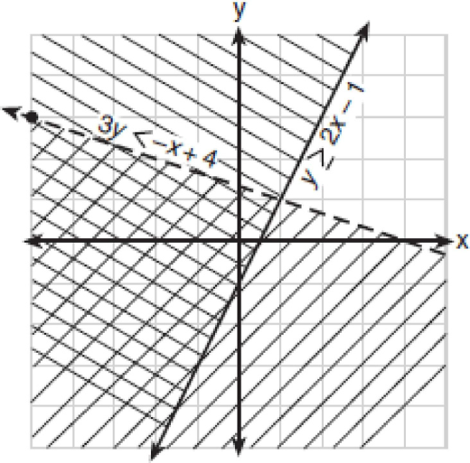
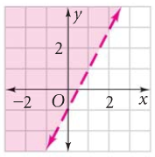
Linear Inequalities (Q)
1)
Write the linear inequality shown in the graph?
2)
Which is in the solution set to the following inequality?
( -3, 1 ) ( 0, -5 )
( 4, 3 ) ( 3, -1 )
3)
Which is in the solution set to the following inequality?
( -3, -4 ) ( 0, 3 ) ( -8, 2 ) ( 2, 5 )
4)
Which is in the solution set to the following inequality?
( 10, -5 ) ( 0, 5 ) ( 9, 2 ) ( 7, -2 )

Slide 10
Linear Inequalities (A)
1)
2)
3)
4)

Slide 11
Solve the System of Inequalities (Q)
1)
2)
3)
4)

Slide 12
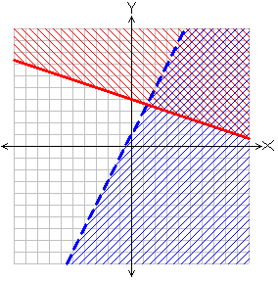
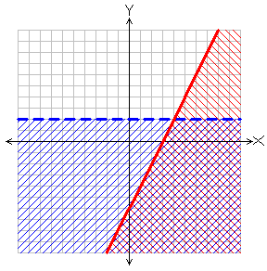
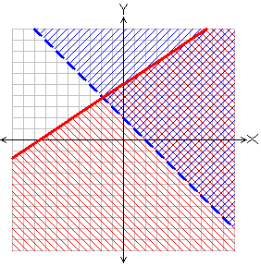
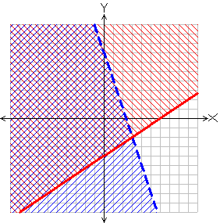
Solve the System of Inequalities (A)
1)
2)
3)
4)

Slide 13
Solve the Quad-Linear System (Q)
1)
2)
Solve the system Algebraically
Solve the system Algebraically
3)
4)
Solve the system Graphically
Solve the system Graphically

Slide 14
Solve the Quad-Linear System (A)
1)
2)
3)
4)

Slide 15
Analyzing Data (Q)
1)
Which set of data can be classified as qualitative?
1) scores of students in an algebra class
2) ages of students in a biology class
3) numbers of students in history classes
4) eye colors of students in an economics class
2)
A school wants to add a coed soccer program. In order to get an unbiased sample, which group should the school survey?
1) every third student entering the building
2) every member of the varsity football team
3) every member in Ms. Kay’s drama classes
4) every student having a second-period French class
3)
4)
Which relationship can best be described as causal?
1) height and intelligence
2) number of correct answers on a test and test score
3) shoe size and running speed
4) number of students in a class and number of students with brown hair
A study showed that a decrease in the cost of
carrots led to an increase in the number of
carrots sold. Which statement best describes this relationship?
1) pos. correlation and a causal relationship
2) neg. correlation and a causal relationship
3) pos. correlation and not a causal relationship
4) neg. correlation and not a causal relationship

Slide 16
Analyzing Data (A)
1)
2)
4) eye colors of students
in an economics class
every third student
entering the building
3)
4)
2) number of correct answers on a test and test score
2) neg. correlation and
a causal relationship

