Slide 1
Are You Smarter Than a 5th Grader?

Slide 2
Are You Smarter Than a 5th Grader?
1,000,000
500,000
300,000
5th Grade Regular Polygons
5th Grade Trapezoids
175,000
100,000
4th Grade Polygon Area
4th Grade Area
50,000
25,000
3rd Grade Shaded Area
3rd Grade Rhombus
10,000
2nd Grade Polygons
2nd Grade Interior Angles
5,000
2,000
1st Grade Types of Triangles
1st Grade Parallelograms
1,000

Slide 3
5th Grade Regular Polygons Question
The sum of the interior angles of a regular polygon is 1800º
Find the measure of a single interior angle
Find the measure of a single exterior angle
Find the number of sides of the figure

Slide 4
5th Grade Regular Polygons Answer
150º
30º
12
Return

Slide 5
5th Grade Trapezoids Question
Find the area of the trapezoid to the nearest tenth.

Slide 6
5th Grade Trapezoids Answer
49.9 ft²
Return

Slide 7
4th Grade Polygon Area Question
Find the area of the polygon to the nearest tenth
16 in
6 in

Slide 8
4th Grade Polygon Area Answer
534.0 in²
Return

Slide 9
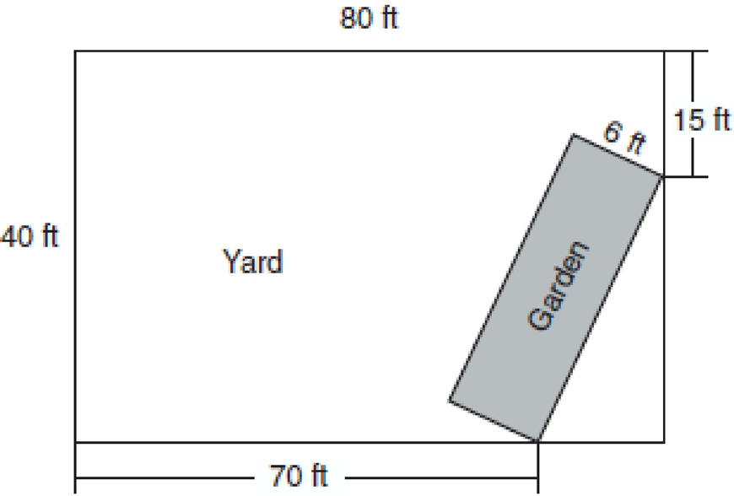
4th Grade Area Question
Find the area of the garden in simplest radical form.

Slide 10
4th Grade Area Answer
Return

Slide 11
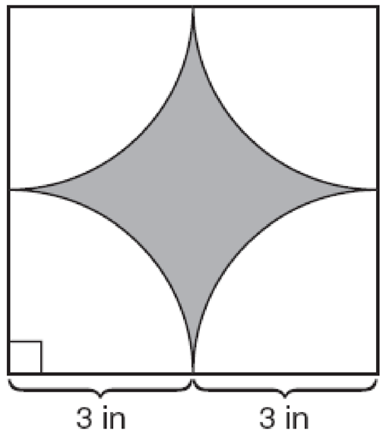
3rd Grade Shaded Area Question
The figure consists of a square and four quarter-circles of equal size. Find the area of the shaded region to the nearest hundredth.

Slide 12
3rd Grade Topic 5 Answer
7.73 in²
Return

Slide 13
3rd Grade Rhombus
In rhombus ABCD, AB = 20 and AC = 33. Find the area of the rhombus to the nearest tenth.

Slide 14
3rd Grade Rhombus Answer
373.0
Return

Slide 15
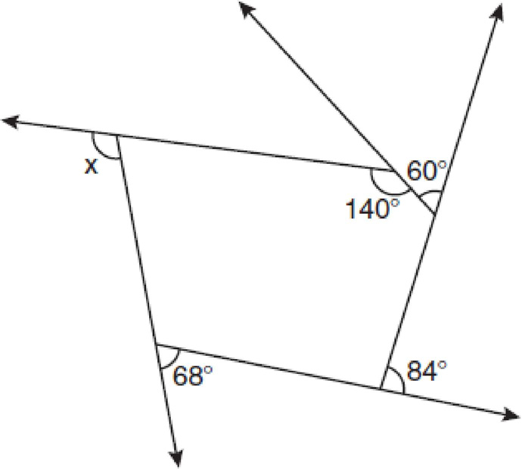
The pentagon in the diagram is formed by five rays. Find the value for x.

Slide 16
2nd Grade Polygons
108º
Return

Slide 17
2nd Grade Interior Angles
What is the measure of each interior angle of a regular hexagon?

Slide 18
2nd Grade Interior Angles Answer
120º
Return

Slide 19
1st Grade Types of Triangles
A triangle has side lengths 15, 36, and 40. Classify the triangle as acute, obtuse, or right.

Slide 20
1st Grade Types of Triangles Answer
Obtuse
Return

Slide 21
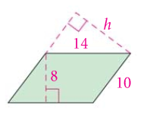
1st Grade Parallelogram Question
Given the following parallelogram, Solve for h.

Slide 22
1st Grade Parallelogram Answer
11.2
Return

Slide 23
Million Dollar Question Area of a Pentagon

Slide 24
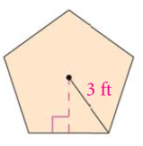
1,000,000 Question
Find the area of the Pentagon to the nearest tenth.

Slide 25
1,000,000 Answer
21.4 ft²
Return

Slide 26
Thanks for Playing!

