Slide 1
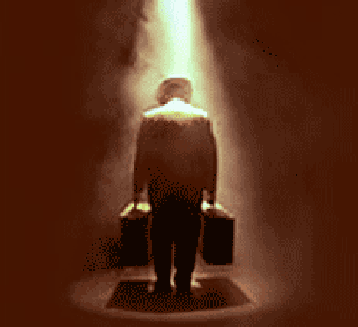
Death of a Salesman
Cross-Analysis Essay

Slide 2
Going Step-By-Step
1. Select One Essential Question
2. Go Through All the Texts and Underline the Quotes You Will Use

Slide 3
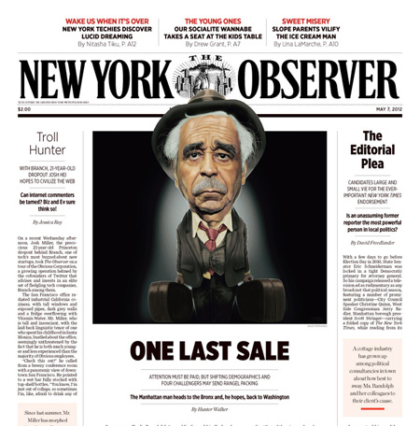
Constructing the Introductory Paragraph

Slide 4
Declarative Thesis
Start With Your Thesis

Slide 5
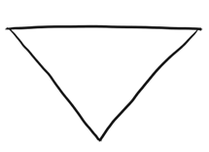
Inverted Thesis
Start Off Broad & General & End With Your Thesis

Slide 6
Declarative Thesis
In today’s economic times, our American society is full of characters like Willy Loman – men and women who cannot live the American dream because it no longer exists. In an era where the national debt is skyrocketing and unemployment rates are at an all time high, it is evident that America is no longer a place of opportunity, but instead, a land of staggering limitations.

Slide 7
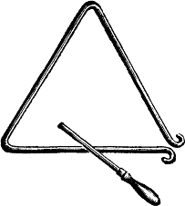
Declarative Thesis
Arthur Miller had it right – America is heading downward at an alarming rate. In the past, Americans could pull themselves up from their bootstraps and make something of their lives through their hard work and determination. But today, things have changed. It used to be that education was the key to success, but obtaining an education is no longer a guarantee to social betterment. Like Biff and Happy, I think that our generation is doomed by economic and political conditions.

Slide 8
Declarative Thesis
Life was easier for our parents and grandparents. All one had to do in the past was work hard and they would almost always be guaranteed success. In today’s society, however, one needs much more than a strong work ethic. America has become the place that Arthur Miller forewarned about – it’s a place of limitations and hardship. Unfortunately, for my generation, we’re destined to be just like Biff and Happy.

Slide 9
GO SYLLOGISTICALLY!!
HMM … HOW DO I WRITE THE BODY PARAGRAPHS?

Slide 10
The Syllogistic Method
1st Premise: A Statement Containing An Argument That You Must Prove
2nd Premise: Textual Support (Quote or Paraphrase)
Conclusion: Textual Analysis (You Quoted … You Need to Analyze It!)

Slide 11
Flipping Trix
You Will Need To Reference Both the Play & At Least One Article In Every Syllogism

Slide 12
Sample 1st Premises: An Argument You Must Prove
In today’s current economic situation, America is full of people like Willy Loman.
America is not the place it used to be.
Just like Biff and Happy, today’s college graduates will be hard pressed to find work.
The American dream was not only dead for the Loman’s. but it is dead for our generation as well.

Slide 13
ALL OF YOUR 1ST PREMISES MUST ARGUE!!

Slide 14
NO PLOT SUMMARY
IN THE
1ST PREMISE

Slide 15
Really Bad 1st Premises
In the play, Willy can’t find work. People in America also are having trouble finding work.
Biff and Happy have to return home because they can’t land jobs.
Willy kills himself at the end of the story.

Slide 16
Sample Syllogism
(1st Premise Must Argue) In today’s current economic situation, America is full of people like Willy Loman. (Need to Draw From the Play and the Articles in the 2nd Premise) Jobless rates are reaching levels that parallel those of the Great Depression in the 1930s. The figures are startling and are leaving many Americans as desperate as the Lohman males. It has become apparent that our country “appears to be a society splitting down the center, shattering the middle class” into two separate spheres of the “Haves” and “Have-Nots” (Alexander). Over 5.9 million Americans are facing the same dilemma as the Loman’s – there simply are not enough jobs for an all too willing workforce. It is not that Willy and his sons are lazy, it is just that “the American social, economic, and political system [is making] it impossible for the individual” to find adequate employment opportunities (Coleman). The number of unemployed …

Slide 17
Americans has grown exponentially over the past eight years. According to the Pew Institute, the number of unemployed in the country will exceed 6.5 million within the coming months. What this means is that approximately ten out of every one hundred Americans is out of work – but what these figures do not reflect are the people like the Loman males that are actively seeking employment yet are coming up empty. (Conclusion of Syllogism Should Link Back to the Essential Question). In past generations, the American dream was something that was very achievable. But today we are crippled by a hobbling economy that is preventing many Americans from obtaining their dreams. In spite of this, I still think that the American spirit is resolved to persevere – just as the Loman’s always kept a little faith.

Slide 18
How Do I Write the Third Paragraph?

Slide 19
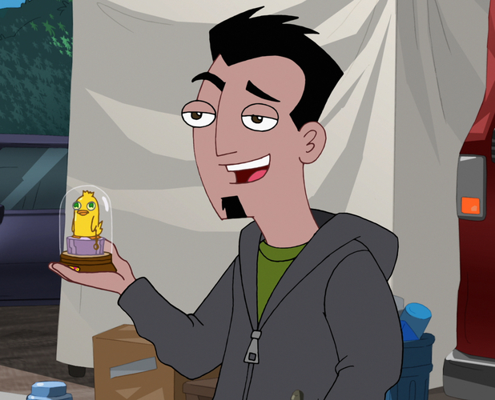
DO
IT
AGAIN!!

Slide 20
The Syllogistic Method
1st Premise: A Statement Containing An Argument That You Must Prove
2nd Premise: Textual Support (Quote or Paraphrase)
Conclusion: Textual Analysis (You Quoted … You Need to Analyze It!)

Slide 21
(Start with an argument) College graduates in America are very likely to experience the same fate as Biff and Happy. (Go get some textual support) There is an unspoken understanding in this country that most teenagers blindly accept – in order to become successful, one must earn a college education. While in the past this concept was by-and-large accurate, it does not seem to be a truism today. According to the U.S. Bureau of Labor Statistics, nearly fifty percent of college graduates under the age of twenty-five are “underutilized, meaning that they’re either working no job at all, working a part-time job or working a job outside of the college labor market.” These figures are alarming because what they suggest is that the American Dream is quite possibly dead. In breaking down the Pew Institutes statistics, during the “boom” years of the mid-1990s, as low as 11 percent of college graduates moved back into their parents homes. In today’s society, last year’s graduating class …

Slide 22
saw 79% of its graduates returning home. These numbers are growing every year. In addition, so are the loans graduates are saddled with. Like Biff and Happy, opportunities are hard to come by for young Americans. (Link the Conclusion of the Syllogism Back to the Essential Question) Obtaining a college education used to lead to great opportunities, but now, for many, it is leading to a brick wall of impossibility. No matter how you spin it, our current economic situation is hurting young Americans. Nobody is immune from it – not even those with a college degree.

