Slide 1
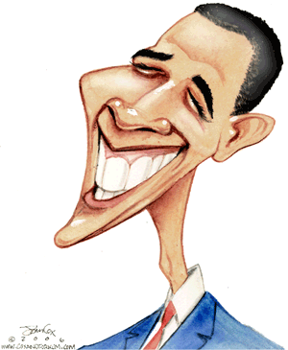
The 2012 Presidential Debates
Link to Debate

Slide 2
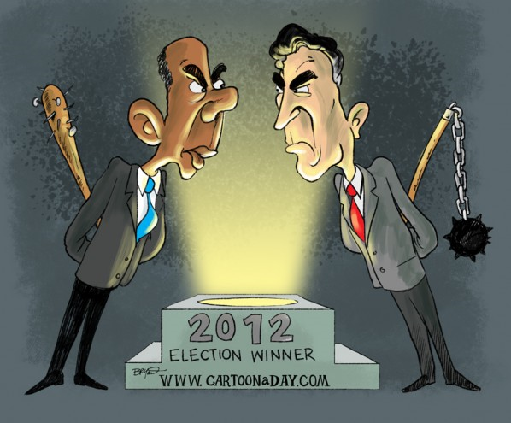
Declarative Thesis
DO IT!!
YOU WON’T
HIT ME WITH A TRIANGLE!

Slide 3
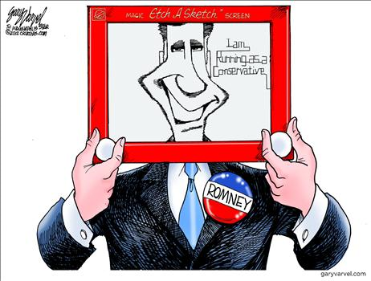
Declarative Thesis
KEEP YOUR LANGUAGE CONCISE !!

Slide 4
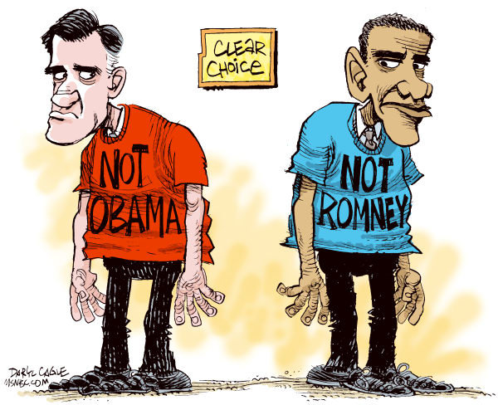
Sample Introduction & Thesis Statement
Arrogance is an ugly personality trait. Romney’s tone was condescending and dismissive, which unfortunately for him, will dissuade independent voters.

Slide 5
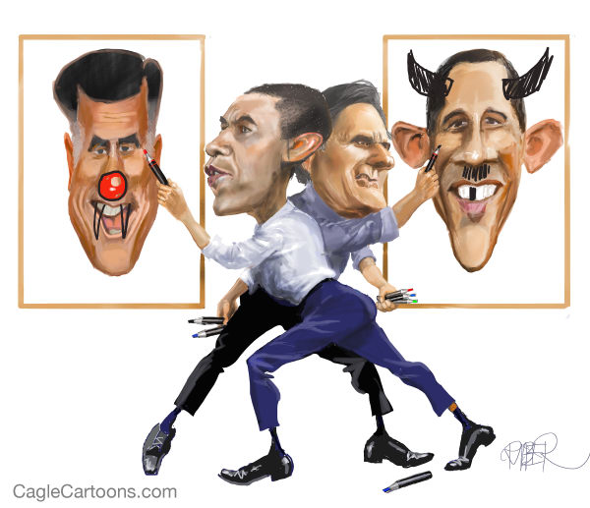
Sample Introduction & Thesis Statement
Hesitation is the antithesis to leadership. Unfortunately for Obama, he lacked confidence and conviction in his responses. These traits led to a convincing loss in the first debate.

Slide 6
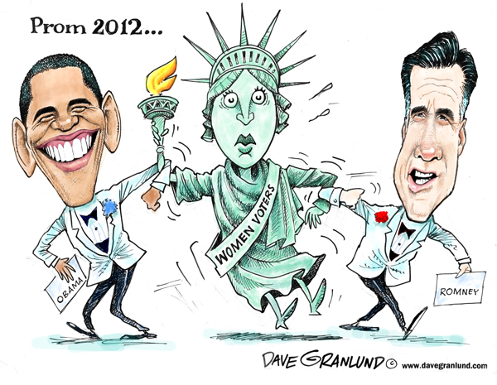
Sample Introduction & Thesis Statement
Obama inherited an America that was hampered by Bush’s poor policy decisions. In the four years since, our country has begun to rebound both economically and socially. He successfully convinced Americans of this fact during the first presidential debate.

Slide 7
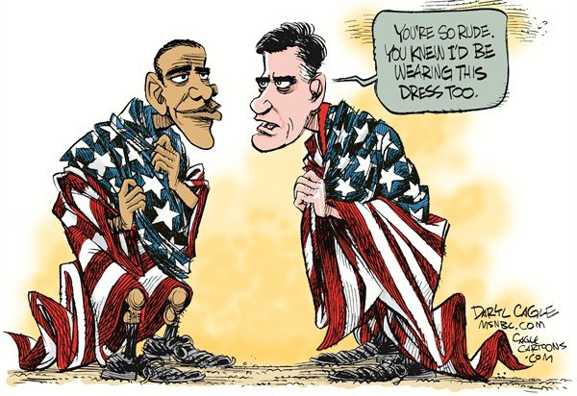
Sample Introduction & Thesis
Obama looked like an ashamed boy being scolded by a parent. He stumbled through his responses like a child struggling to explain his wrongdoings. Romney was much more in control and therefore won the debate.

Slide 8
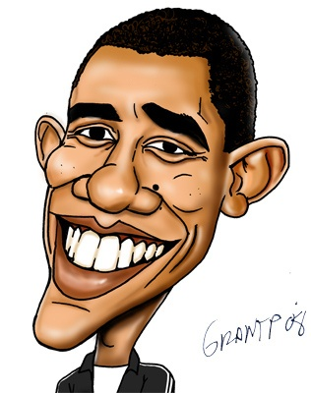
Constructing the Syllogisms
IT’S PROBABLY A GOOD IDEA TO GET SOME TEXTUAL SUPPORT FROM THE “FACT CHECKER”
LOOK INTO EACH CANDIDATE’S ETHOS
Fact Checker

Slide 9
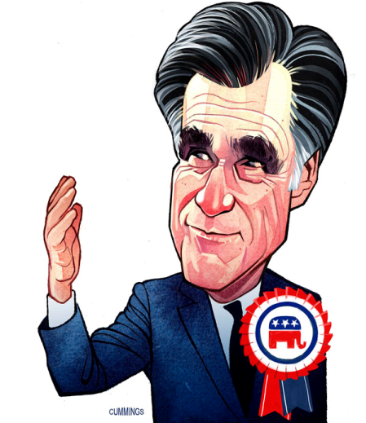
Revisiting the Syllogistic Method
1st Premise: Statement that contains an argument OR a literary term
2nd Premise: Textual Support
Conclusion: Textual Analysis

Slide 10
Energy independence is crucial for the sovereignty and prosperity of our nation. Romney’s plans to lesson our dependence on Middle Eastern oil reserves makes perfect sense – yet, however – the Obama administration has hindered this from happening. Romney claims that under the current regime, the number of “in-house” drilling permits and licenses on government owned lands has been cut by more than half of that of the previous administration. Despite our nations rich resources, the Obama team has thwarted the development of the Keystone Pipeline, offshore drilling, and hydrofracking. Romney sees this as a problem because “all of the increases in natural gas and oil has happened on private land.” This is a problem according to Romney because not only does it make us strapped to nations that are not always our allies, but it hurts the economy and the middle class by driving up gas prices. Romney has a plan to “increase the number of drilling permits on federal lands by at least fifty percent.” By cutting the number of permits and licenses in half, Obama has put America’s energy policies on the wrong path.

Slide 11
What Are Your Targets?
1st premises that are concise and argue
Provide sufficient textual support to fully prove your argument
Embed Your Quotes
Lots of Textual Analysis

Slide 12
Romney’s economic stimulus package would lead our country further into debt. In addition, his lack of clarity during the debate was alarming. At one point her went on record as saying – “My economic plan calls for a $5 trillion tax cut – on top of the extension of the Bush tax cuts – that’s another trillion dollars.” The basic mathematics of his argument simply do not add up, especially when he later nullified his previous remarks by saying – “I don’t have a $5 trillion tax cut.” The simple fact is that both positions work against each other quite paradoxically. By proposing to cut taxes by a rate of twenty percent by 2015, Romney would have to generate $500 billion in revenue to cover the cost. This simply cannot be done, as Obama noted several times – the numbers do not add up. Given this uncertainty, the Obama campaign can only but doubt the effectiveness of Romney’s plan – that it would in fact mean higher taxes for middle-class Americans – even though – as Romney declared – “there is no chance [he] would try to implement such a proposal.” Conversely, Obama’s plan has a balanced approach. And as he stated several times, the economy is in fact doing …

