Slide 1
Wolves In Sheep’s Clothing
Writing Workshop

Slide 2
Thesis = Precision + “Big Picture”
Throughout the article “Wolves in Sheep’s Clothing,” Norma Rogers presents irrelevant pathos and ethos by intentionally implementing a red herring to distract from her flawed logos. What first comes off as genuine maternal concern, later emerges as little more than racist and classist sentiment that is the true wolf in sheep’s clothing.

Slide 3
Thesis = Precision + “Big Picture”
Norma Rogers makes use of red herrings and sweeping generalizations to present her racist and classist sentiments. She also establishes her pathos to advance her seemingly unshakable credibility and allegiance with concerned parents, only to witness her argument implode as her true ideological motives manifest themselves from behind a crumbling façade.

Slide 4
Thesis = Precision + “Big Picture”
In Norma Rodgers’ article “Wolves in Sheep’s Clothing”, Rodgers asserts her ethos to unintentionally employ a dicto simpliciter that greatly impedes her intent. By overwhelming the reader with extensive statistics and misleading facts, Rodgers hides her hidden motive of a racist, classist, and elitist itinerary.

Slide 5
Thesis = Precision + “Big Picture”
In her article, Norma Rogers portrays dicto simpliciter and the red herring fallacies to enhance her credibility and appeal to the reader’s instincts. These fallacies help mask her real motives as a racist, classist and elitist writer.

Slide 6
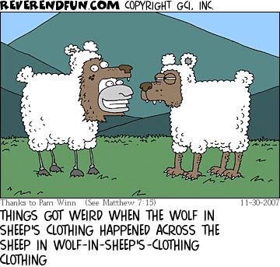
Thesis = Precision + “Big Picture”
Norma Rogers attempts to employ red herrings and ethos to draw the reader’s attention from her flawed logic and justify her flawed ideals concerning children’s television. Analysis of the writing reveals logical fallacies which show the true background of her arguments. Beyond the thin veil of credibility, her writing is obviously fueled by racism, classism, and elitism.

Slide 7
Bank of Dynamic, Precise, Literary 1st Premises
 Rogers intentionally employs argumentum ad neauseum to conceal the true intent of her agenda
 By manipulating an intentional red herring, Rogers attempts to boost her ethos, as well as distract from her flawed logos.
Rogers manipulates a red herring by overcompensating her argument with statistics to distract her audience from her thesis and boost her ethos with research.
 Roger’s uses red herring numerous times throughout the article, presenting irrelevant statistics to build her ethos and distract from her flawed logos.

Slide 8
1st Premise Bank
By presenting overwhelming amounts of evidence and statistics, Rogers creates a red herring that helps heighten her credibility, while simultaneously hiding her flaws.
Although Norma Rogers inserts a large amount of ethos into her writing to make her arguments believable, her bigotry and multiple logical fallacies nullify any credibility she would have had.
Rogers’ intent is to magnify her credibility while appealing to fellow mothers through pathos.
In “Wolves in Sheep’s Clothing,” Rogers employs red herrings to distract readers from her true assertions and to promote her ethos.
Rogers manipulates red herring in her article to boost her ethos and distract the reader from her true thesis.

Slide 9
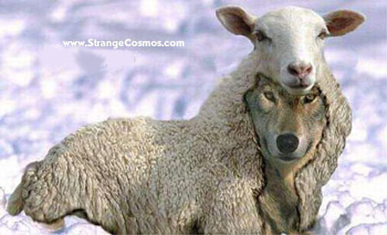
Body Paragraphs  Go Syllogistically  Embed  Support  Prove
By presenting overwhelming amounts of evidence and statistics, Rogers creates a red herring that helps heighten her credibility, while simultaneously hiding her flaws. She avoids giving us her thesis at first, instead engulfing her readers in statistics that prove how “66% of children’s programming [have] violence” along with “sexual innuendo[s]”, “adult language”, “trash talking, bullying and disrespect”. Other research shows that “exposure to TV violence [is] associated with aggressive behavior in some children”, seeing as “young children are especially impressionable”. (OVER)

Slide 10
By providing her readers with ample amounts of information, Rogers boosts her credibility as they are now under the impression that she is knowledgeable about what she is talking about. Rogers then explains the show “Higglytown Heroes” and how the show portrays the “sanitation workers to the glorified pizza delivery guy[s] [as] ‘heroic’ simply because they are doing their jobs.” When she jumps to the show “Dora the Explorer”, Rogers asks why Dora will not adapt to the American culture, claiming “when my Sicilian relatives arrived at Ellis Island in 1909 not speaking a word of English, their willingness to assimilate allowed them to ‘participate’ in this country.” At the end of her article, Rogers’ thesis is still unclear, leaving us with bundles of information that we are left to make our own judgments from. After analyzing the statistics along with her arguments, it becomes obvious of her use of the red herring fallacy. Rogers presents evidence of violence and aggressive behavior in children’s cartoons to distract her reader from her underlying motives as a racist, a classist, and an elitist. The statistics build her ethos to her readers, increasing the chances that they will ignore the holes in her argument and align themselves with her opinions, when in reality the statistics have no relevance to her argument at all. In TV shows such as “Higglytown Heroes” and “Dora”, her two examples, violence, sexual innuendos, and bullying or disrespect aren’t present at all. We can see Rogers’ real motives when she introduces her feelings of how the sanitation workers and pizza men in “Higglytown” aren’t heroes simply because “they are just doing their jobs”, showing her classist and elitist attitude. Her racist opinions come out in attacking “Dora” based on her Hispanic origin, claiming that she should assimilate into our society. In reality, Dora speaks English for a majority of the show, only throwing in a few Spanish words here and there. Although her use of the red herring fallacy boosts her ethos and hides her actual motivation for the piece, Rogers’ racist, elitist and classist opinions are still conveyed through careful and intensive analysis.

Slide 11
Body Paragraphs  Go Syllogistically  Embed  Support  Prove
In “Wolves in Sheep’s Clothing,” Rogers employs red herrings to distract readers from her true assertions and to promote her ethos. Rather than opening her piece with a thesis, as is considered the acceptable way to make an argument, Rogers goes on a tangent. She builds her ethos, emphasizing how she is “so vigilant about protecting the innocence of [her] kids.” This is an attempt to reach out to mothers, to get them to side with her before they even know her claims. Her research on the subject is also evident; she is displaying her knowledge for all to see. She intelligently tells readers how “in 1990 the Children’s Television Act took significant measures to provide quality programming to children.” The Act is then discussed in further detail. Although this research may be impressive, she still doesn’t tell us what it is she wants to prove. (OVER)

Slide 12
This is not the only red herring in the text. Rogers finally divulges her thesis, only to determine that “Before [she] substantiate[s] [her] claims,” she has to allow “the reader to understand the historical background that informs [her] rationale.” She then recites a long list of statistics about “violence that is present in today’s programming for children,” as well as “sexual innuendo[s]” and “adult language . . . trash talking, bullying, and disrespect.” This is a red herring because none of these statistics have any relevancy to her arguments against Higgleytown Heroes, Dora the Explorer and Handy Manny. Nowhere in her reasoning does she say these shows have any of these issues present. This data serves two purposes, firstly to distract the reader from her actual reasoning. Secondly, to further uphold her ethos. Data this intensive tells readers that Rogers is an expert in the matter; one should trust her. That is her aim. These red herrings are an integral portion of Rogers’ efforts to persuade readers to naïvely agree with her.

Slide 13
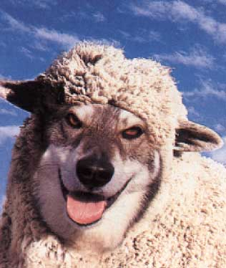
Body Paragraphs  Go Syllogistically  Embed  Support  Prove
Rogers cleverly utilizes diction to bait the reader and create a strong pathos in order to contort her theme. She claims that she is a “woman of faith” who is “vigilant about protecting the innocence of [her] kids”. Rogers even mentions that “the Lord tells us, we'll reap what we sow”. Her obvious aim was to convince the reader that her motives were truly innocent and that her intent wasn't flawed in any way. By establishing this strong pathos right from the beginning, Rogers creates a “safe” environment for her theme to blossom.

