Slide 1
Independence in Southeast Asia
The Philippines
Myanmar(Burma)
Malaysia & Singapore
Indonesia
East Timor

Slide 2
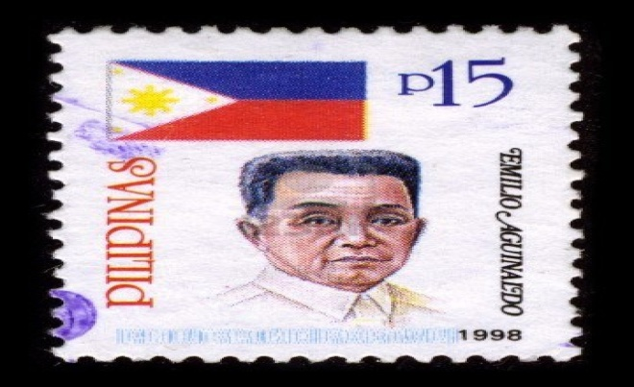
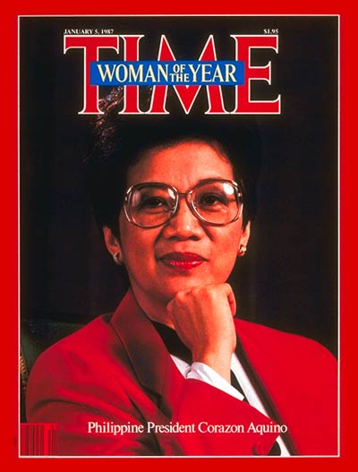
The Philippines
Corazon Aquino
The Philippines had been a Colony of the US since the Spanish-American War when the US took control from Spain
The US used the Philippines as a military & naval base during WWII & the Cold War & paid the Filipinos $620 million in damages due to WWII
On July 4, 1946 the US officially gave the Philippines their independence but maintained a 99 year lease (Bell Act) on the military bases.
The US finally agreed to give up the bases in 1992 (*the same year Mt. Pinatubo erupted & thousands of Filipinos died)
Ferdinand Marcos was elected president of the Philippines in 1965. He ruled until 1986 and stole an estimated $475 million from the treasury. He imposed martial law (military rule) and ruled harshly, often killing his opponents like Benigno Aquino.
In 1986 Aquino’s widow Corazon Aquino defeated Marcos in the elections but Marcos declared himself the winner.

Slide 3
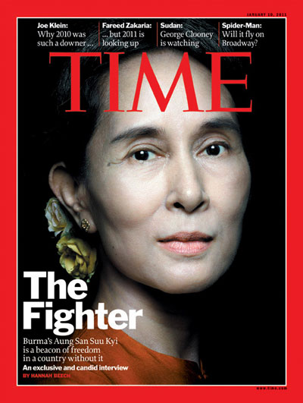
Myanmar(Burma)
Aung San Suu Kyi
Burma gained independence from Great Britain in 1948 after WWII. In 1989 it officially changed its name to Myanmar which was its name in Burmese before the British colonized it.
Burma suffered from a series of political crises where military coups were common & efforts toward democracy were suppressed. Communists also threatened its stability.
In 1962 General Ne Win set up a military government with the goal of creating a socialist state. He stepped down from power in 1988, but the military continued to rule Burma harshly.
In 1988 Aung San Suu Kyi, the daughter of an assassinated government official helped create & lead the National League for Democracy. She was placed under house arrest for years by the military government despite the National League for Democracy winning the election in 1990.
She was freed in 1995 but house-arrested again multiple times since & has been unable to claim her Nobel Peace Prize as a result.

Slide 4
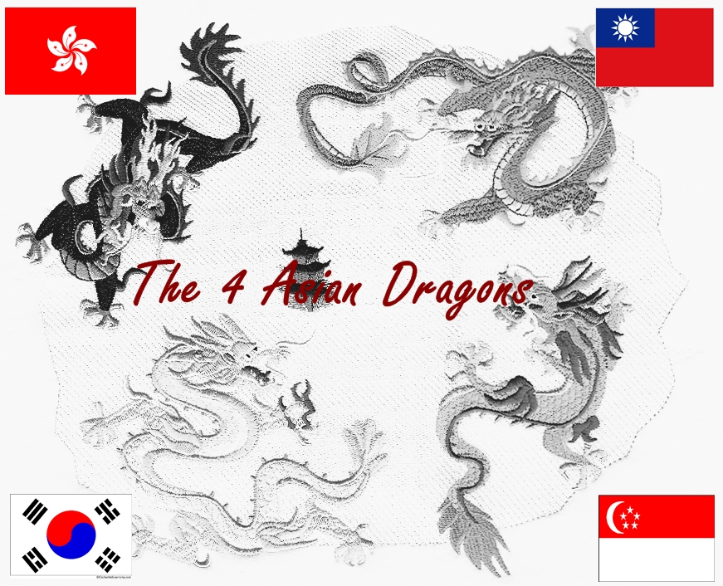
Malaysia & Singapore
During WWII the Malay Peninsula was conquered by the Japanese after being ruled by the British.
In 1945 after Japan was defeated the British returned to try & organize the different peoples into one state amidst communist uprisings.
The many ethnic groups in the region resisted British efforts & in 1957 officials created the Federation of Malaysia from Singapore, Malaya, Sarawak & Sabah. The regions were separated by 400 miles of ocean.
In 1965 Singapore separated from the federation & became an independent city-state.
The remaining federation became known as Malaysia.
Singapore today is considered to be one of the Asian Tigers (Dragons) economically

Slide 5
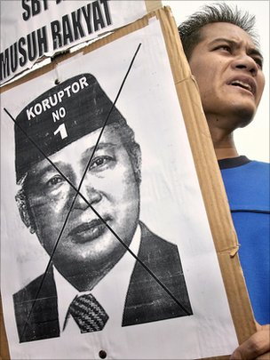
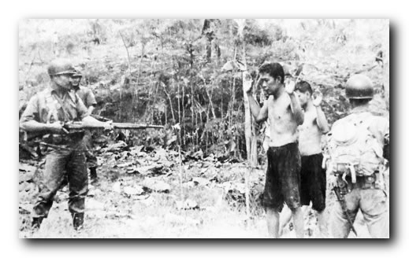
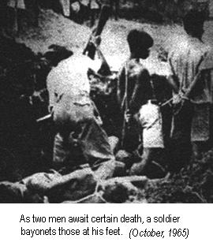
Indonesia
Suharto
The Dutch had controlled Indonesia prior to WWII. Japan conquered the region as it did many other colonies in Southeast Asia.
After the Japanese were defeated Indonesia moved toward independence under the leadership of Sukarno in 1945. The Dutch granted Indonesia independence in 1949 after the US & UN supported Sukarno’s government.
Indonesia has the 4th largest population in the world, over 13,600 islands & over 300 different ethnicities & 250 languages.
Sukarno was unable to meet the needs of the diverse nation & its economy began to crumble, experiencing hyperinflation as high as 1000%. This led to political opposition by students who helped overthrow (*coup) Sukarno in 1965.
General Suharto seized power after the coup & immediately began a policy of genocide, killing between 500,000 & 1 million Indonesians (*many were Chinese immigrants who supported communism)
Suharto ruled Indonesia under martial law (military rule) & annexed East Timor in 1976. Indonesia was noted for corruption &human rights abuses under his rule

Slide 6
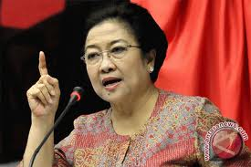
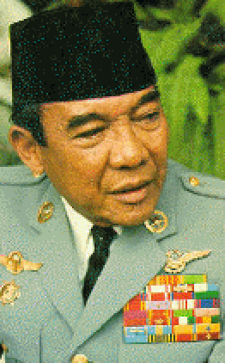
East Timor
Megawati
Sukarnoputri
Indonesian forces had ruled East Timor since Suharto seized control of it in the 1970s. He ruled & controlled it using brutality & military rule.
Jose Ramos Horta won the Nobel Peace Prize for his efforts to lead a non-violent independence movement in East Timor in 1996.
In August, 1999 East Timor voted overwhelmingly for independence, but Indonesian forces responded violently, killing hundreds & detaining others in refugee camps.
UN forces finally brought peace to the area in 2002, when East Timor celebrated its independence.
Sukarno (Megawati’s father)

