Slide 1
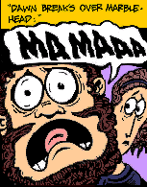
Oedipus the King
Writing Workshop

Slide 2
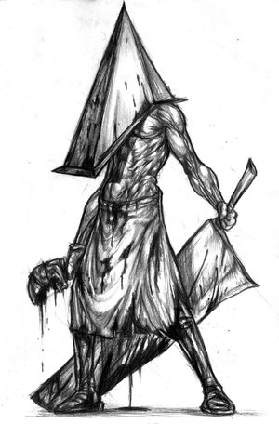
Declarative Thesis
START WITH YOUR THESIS … YOUR MAIN POINT

Slide 3
Sample Declarative Thesis
Through dramatic irony and a binary inversion, Sophocles resolves the Riddle of the Sphinx to illustrate Oedipus’ plight. In blindness one finds darkness, but In Oedipus’ case, his demise provides the light of his self-realization.

Slide 4
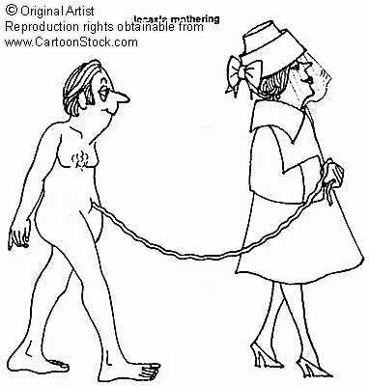
Sample Declarative Thesis
Sophocles inverts the binary of light and darkness to reveal Oedipus’ ironic fate. With his sight intact, Oedipus is in the proverbial dark – he is unable to see the role he plays within the context of the oracle. It is only through blindness is he able to see the “light” of his ways.

Slide 5
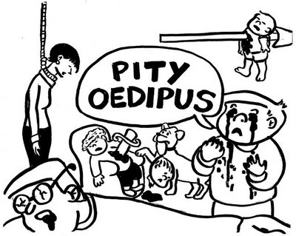
Sample Declarative Thesis
Knowledge is typically associated with lightness, while ignorance is linked to darkness, but Sophocles inverts this paradigm to fuel the dramatic irony within his play. It is only through this dark blindness that Oedipus begins to see the light of his true character.

Slide 6
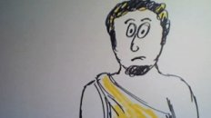
Sample Introduction
The use of dramatic irony and a climactic binary inversion create the mystery, and solution, of Oedipus the King. Sophocles’ light and dark, and sight and blind binaries are analogous to the mystery and knowledge Oedipus faces. The final scene – where blindness and understanding are united – resolves the agonizing dichotomy of sight and confusion.

Slide 7
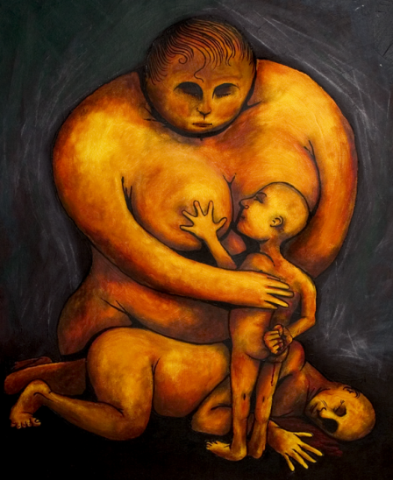
Sample Introduction
Sophocles embeds his “Oedipus the King” in doubt with regard to the true paternity of Oedipus and the validity of oracles. However, the revelation of truth is far from the crux of the work; through situational irony, the audience is already aware of the outcome. It is the process of dramatic realization, the play and inversion of light and dark, knowledge and ignorance, that builds on the meaning of the play and gives life to its plot.

Slide 8
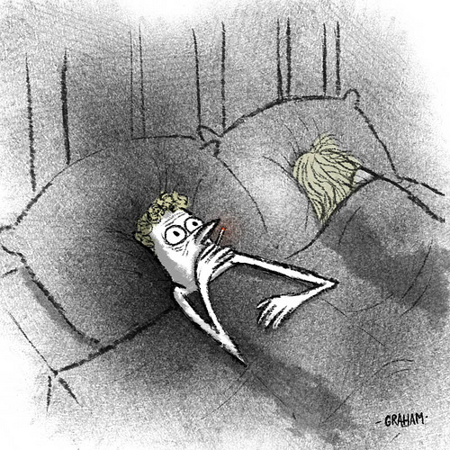
Revisiting the Syllogistic Method
1st Premise: Statement that contains an argument OR a literary term
2nd Premise: Textual Support
Conclusion: Textual Analysis

Slide 9
The prevailing binary of light and blindness, sight and darkness, emerges in one of the very first scenes and continues throughout the play. In the beginning, Oedipus questions Teiresias about a prophecy that claims Oedipus will slay his father and wed his mother. Dissatisfied with Teiresias’ answer that points the finger of blame towards the king, Oedipus turns toward the prophet and claims him blind, cloaked in darkness, incapable of seeing the truth. At the same time, he relates to himself as enlightened and knowledgeable, presenting his mastery of the Sphinx riddle as evidence of his greatness. But as the audience is already aware, it is Oedipus who is in the dark, in denial of the possibility that he could be the reason for the plague upon his city. The binary that develops at the start of the play forms the foundation for the rest of the play as Oedipus struggles to break through into the light and discover his true origins. It presents a convenient opportunity to elaborate on characterization and embellish the plot of the story.

Slide 10
What Are Your Targets?
1st premises that are concise and argue
Provide sufficient textual support to fully prove your argument
Embed Your Quotes
Lots of Textual Analysis

Slide 11
At the end of the play, Sophocles inverts this binary, giving new meaning to the qualities of darkness and sight. As Oedipus mourns the somber death of his wife and mother, he arrives at the conclusion that as long as he has his sight, he will be forever trapped in the world of darkness, unable to escape from the constant reminder of his faults. Gouging out his own eyes with the broach of his wife, Jocasta, Oedipus reverses the juxtaposition of knowledge and ignorance, plunging into the realm of darkness, finally surrendering to the “light”. This climatic portion of the play is the summit of all the previously established drama and irony. As the audience grieves at the inevitable tragedy, it also marvels at the emotional pinnacle developed through the binary and its inversion.

