Slide 1
Refraction
Assignment #4
Page 8

Slide 2
Wave Phenomena
Read pages 13-15 in Unit 14 Packet

Slide 3
Light Bends as it enters a New Medium
Normal
53°
Air
Lucite

Slide 4
Frequency
Frequency is dependent on the source.
The source of the light does not change!
Frequency does not change!
f = 5.0 x 10¹⁴ Hz

Slide 5
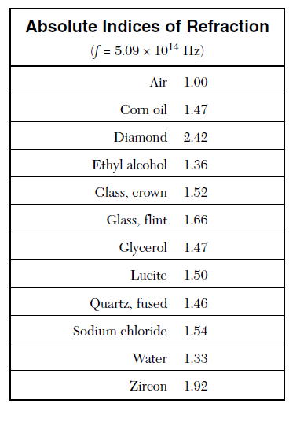
Index of Refraction
Take a look at your
reference table…
“n” values on p. 2 of
Ref. Tables!

Slide 6
Angle of Refraction
Snell’s Law
n and angle for air = n and angle for lucite
(1.00) (sin53⁰) = (1.50) sinѲ
sinѲ = 0.53
Ѳ = sin⁻¹(0.53)
Ѳ = 32 ⁰
Degree
Mode!!

Slide 7
Drawing the Angle of Refraction
Normal
53°
Air
Lucite
32⁰

Slide 8
Velocity
Velocity changes as the wave changes medium!!
Equation from reference table:

Slide 9
Velocity
Equation from reference table:
v = 2 x 10⁸ m/s

Slide 10
Wavelength
Equation from reference table…
λ = 4 x 10⁻⁷ m or 400 nm

