Slide 1
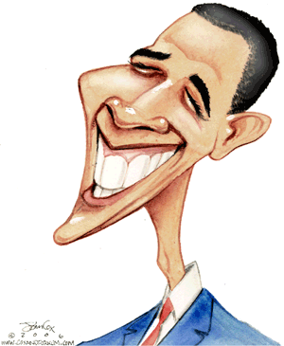
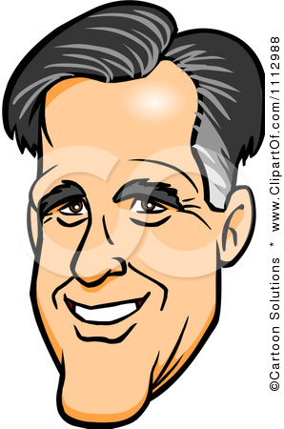
The 2012 Presidential Debates
Link to Debate

Slide 2
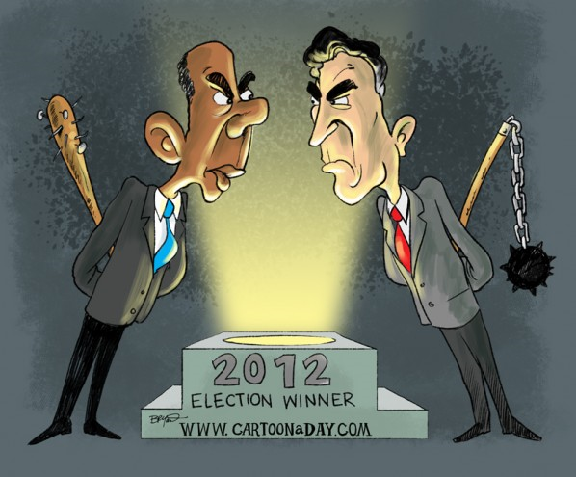
Declarative Thesis
DO IT!!
YOU WON’T
HIT ME WITH A TRIANGLE!

Slide 3
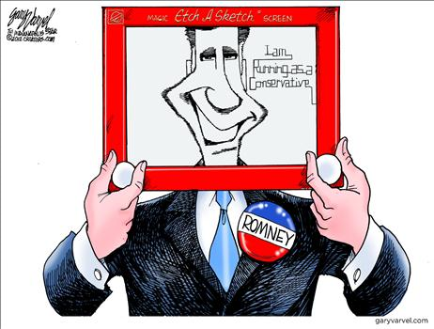
Declarative Thesis
KEEP YOUR LANGUAGE CONCISE !!

Slide 4
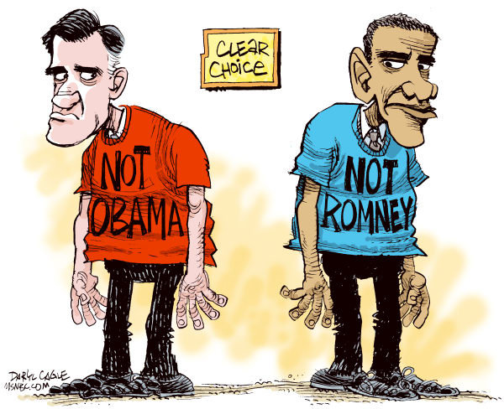
Sample Introduction & Thesis Statement
Arrogance is an ugly personality trait. Romney’s tone was condescending and dismissive, which unfortunately for him, will dissuade independent voters.

Slide 5
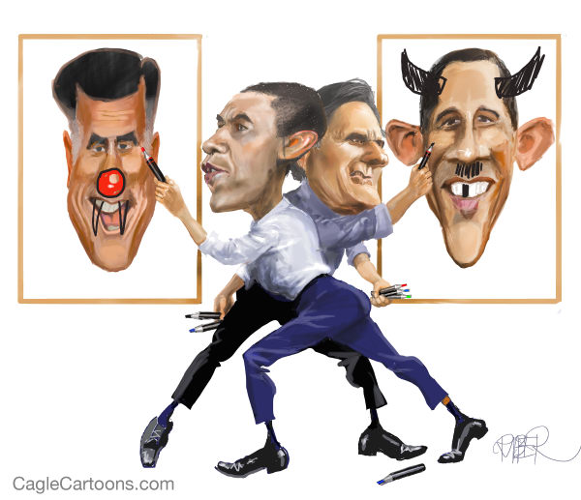
Sample Introduction & Thesis Statement
Hesitation is the antithesis to leadership. Unfortunately for Obama, he lacked confidence and conviction in his responses. These traits led to a convincing loss in the first debate.

Slide 6
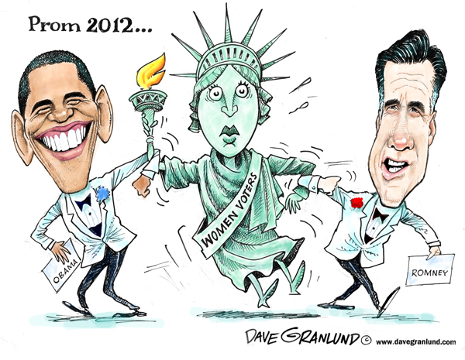
Sample Introduction & Thesis Statement
Obama inherited an America that was hampered by Bush’s poor policy decisions. In the four years since, our country has begun to rebound both economically and socially. He successfully convinced Americans of this fact during the first presidential debate.

Slide 7
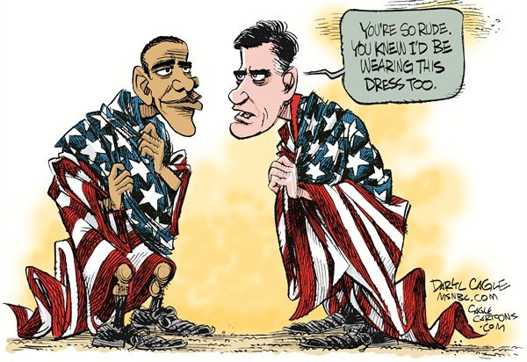
Sample Introduction & Thesis
Obama looked like an ashamed boy being scolded by a parent. He stumbled through his responses like a child struggling to explain his wrongdoings. Romney was much more in control and therefore won the debate.

Slide 8
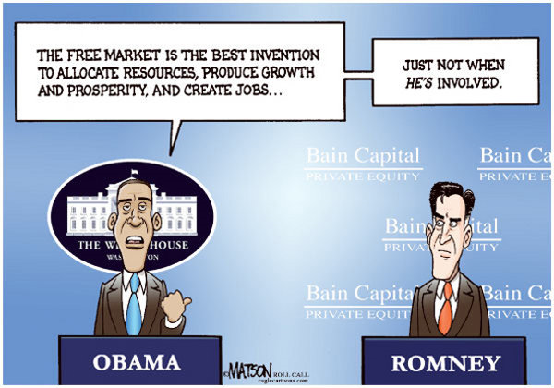
Student Sample
Candidate Mitt Romney during the presidential debate displays arrogance and self-importance during his opinions and interactions to gain votes against opposing candidate Barack Obama. Using body language to portray emphasis, interrupting the moderator to counter arguments, and displaying ignorance to the average person's interests, Mitt Romney's pro-upper class aggressiveness is evident, indicating his unpopularity in this debate and affecting his credibility among the common, middle-class population.

Slide 9
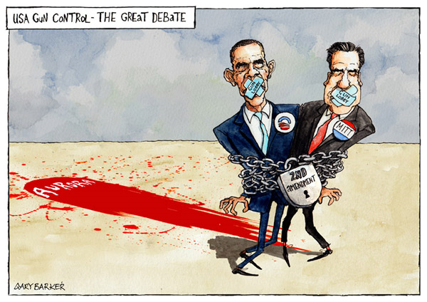
Student Sample
President Obama’s unconfident demeanor and his lackluster performance ensured Romney’s victory in the debate. President Obama stuttered often in his speech, and even seemed to stand too casually at some points- traits that the leader of America should not show. These poor qualities demonstrated by the President lead Romney to claim triumph over President Obama.

Slide 10
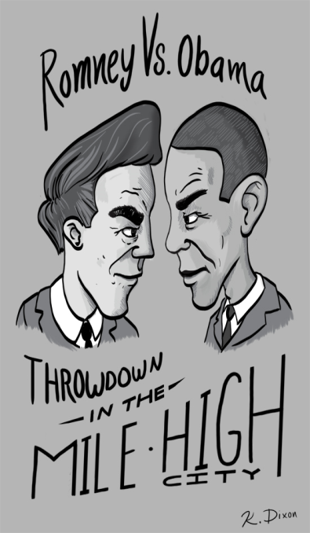
Student Sample
The strong, confident body language of Romney in contrast to Obama’s impromptu appearance bolstered Romney’s evident success in the first presidential debate. The ability to persuade the audience through his tone and substance and articulate himself added to Romney’s dominating performance.

Slide 11
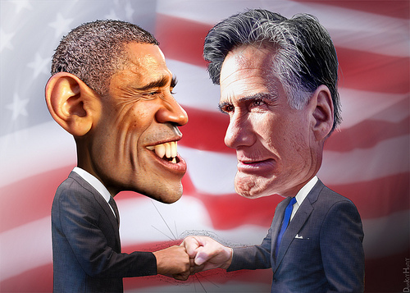
Student Sample
Being assertive is an essential quality to possess in order to lead an entire nation. Romney won the first presidential debate because he seemed to have the most authority on stage which depicted him as a powerful individual.

Slide 12
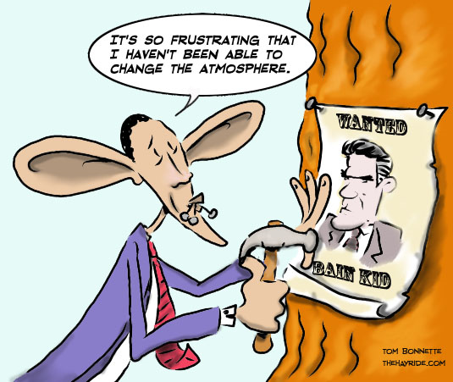
Student Sample
The most vital traits the American public seeks in a leader are compassion and interpersonal skills, which fortunately for Obama, Romney failed to demonstrate in the debate. Romney's condescending smirks and interruptions came back to bite him, since they portrayed him as a jealous governor lacking the poise of the president.

Slide 13
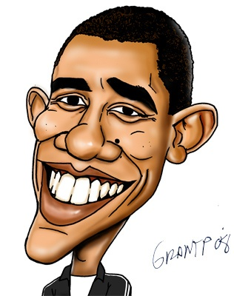
Constructing the Syllogisms
IT’S PROBABLY A GOOD IDEA TO GET SOME TEXTUAL SUPPORT FROM THE “FACT CHECKER”
LOOK INTO EACH CANDIDATE’S ETHOS
Fact Checker

Slide 14
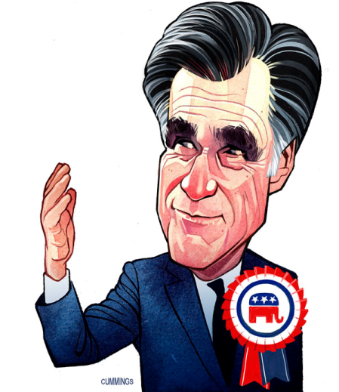
Revisiting the Syllogistic Method
1st Premise: Statement that contains an argument OR a literary term
2nd Premise: Textual Support
Conclusion: Textual Analysis

Slide 15
Energy independence is crucial for the sovereignty and prosperity of our nation. Romney’s plans to lesson our dependence on Middle Eastern oil reserves makes perfect sense – yet, however – the Obama administration has hindered this from happening. Romney claims that under the current regime, the number of “in-house” drilling permits and licenses on government owned lands has been cut by more than half of that of the previous administration. Despite our nations rich resources, the Obama team has thwarted the development of the Keystone Pipeline, offshore drilling, and hydrofracking. Romney sees this as a problem because “all of the increases in natural gas and oil has happened on private land.” This is a problem according to Romney because not only does it make us strapped to nations that are not always our allies, but it hurts the economy and the middle class by driving up gas prices. Romney has a plan to “increase the number of drilling permits on federal lands by at least fifty percent.” By cutting the number of permits and licenses in half, Obama has put America’s energy policies on the wrong path.

Slide 16
What Are Your Targets?
1st premises that are concise and argue
Provide sufficient textual support to fully prove your argument
Embed Your Quotes
Lots of Textual Analysis

Slide 17
Romney’s economic stimulus package would lead our country further into debt. In addition, his lack of clarity during the debate was alarming. At one point her went on record as saying – “My economic plan calls for a $5 trillion tax cut – on top of the extension of the Bush tax cuts – that’s another trillion dollars.” The basic mathematics of his argument simply do not add up, especially when he later nullified his previous remarks by saying – “I don’t have a $5 trillion tax cut.” The simple fact is that both positions work against each other quite paradoxically. By proposing to cut taxes by a rate of twenty percent by 2015, Romney would have to generate $500 billion in revenue to cover the cost. This simply cannot be done, as Obama noted several times – the numbers do not add up. Given this uncertainty, the Obama campaign can only but doubt the effectiveness of Romney’s plan – that it would in fact mean higher taxes for middle-class Americans – even though – as Romney declared – “there is no chance [he] would try to implement such a proposal.” Conversely, Obama’s plan has a balanced approach. And as he stated several times, the economy is in fact doing …

Slide 18
Student Sample
Romney's hypocritical statements and constant ironies caused his egos to be shattered and him to be non relatable to the general public. Romney's main focus of the debate was his plan to increase jobs in America. Unfortunately, however, he contradicted himself when he stated that he also plans to "make government more efficient and cut back the number of employees." This is the ultimate paradox since he more or less admitted that his personal choices will not reflect the promises he is making in his campaign regarding jobs. All credibility was lost on this ironic comment. His logos was also destructed since his logic for the bettering of the economy is apparently not applicable to him, and therefore not applicable at all. Another of Romney's main points in the debate was his eagerness to help the middle-class in this economy because they have been suffering under Obama. Interestingly enough, he reveals that he's "not going to reduce the share of taxes paid by high-income people. High-income people are doing just fine in this economy." Romney's remark comes off as condescending and inconsiderate toward the middle and lower classes who are perhaps not doing as well in this economy. If he wanted to appeal to the middle class, sharing that the upper class won't have to bend at all to help the others probably wasn't the smartest choice. Also, subtly putting down the non-elite can only anger these target voters. Romney's own elitist attitude and failure to sympathize with the American people lost him not only relevance, but also the debate.

Slide 19
Student Sample
Too frequently, Obama hesitated in his speech, and paused between his thoughts for a lengthy amount of time- these disruptions made him sound unreliable. Faltering in his speech doomed the President right from the opening of the debate, because it gave onlookers the impression that “he doesn't know what he wants to say next.” Not knowing what to talk about in the debate showed weakness and an inability to have control. The leader of our nation should not be shaky in the face of his opponent, or while the whole country is intently watching him. In addition, he certainly should have been in control; he was entering the debate ahead of Romney, so Obama should have displayed confidence, which would have put him in control. Instead, “his speech in general was quite awkward,” which put Romney in control. Obama’s inability to recover from his floundering allowed Romney to stay ahead, which ultimately brought the Republican candidate to victory.

Slide 20
Student Sample
Known by most as a charismatic speaker, Obama disappointed his audience thanks to Romney’s surprising speech which forced the president to focus on the new proposals that Mitt Romney was discussing, rather than focus on his own staple of powerful speaking. Obama was ready for a debate with Romney’s policies that he had openly supported, but in the debate he changed many of those policies and Barrack Obama had not prepared for it. This switch up was perfect for Romney to gain the upper hand as Obama was sorting out how to respond, and not paying attention to how good of a speaker he was being, while Romney had prepared his speech and new policies thoroughly and was completely prepared to win the debate. Mitt Romney knew he would be able to gain an advantage in this debate because Obama’s best option was to play it safe, seeing as he had the popular vote, but Romney had made it a point to not let Obama be able to plan out his speech beforehand, and to force him to hastily deal with all of Romney’s new policies. This tactic of surprising the president while he was playing it safe paid off for Romney, leaving Obama unsure of what to say at many times, allowing the republican candidate to win the first debate.

Slide 21
Student Sample
Providing insurance for people with pre-existing conditions has been a major topic of debate. After falsely attacking Obama’s healthcare plan, Romney attempts to project a positive outlook on his own plan. Proudly and firmly, Romney exclaims “pre existing conditions are covered under my plan.” However, Romney’s campaign clarifies that the Governor does not believe “insurance companies should have to cover people with pre-existing conditions who have not had continuous health care coverage” which acts paradoxically with his original statement. Currently there are between 50 million and 129 million people who have pre-existing conditions - and “twenty-five million of those do not have health insurance.” Obama on the other hand, is on the mission to solve this problem and has “created special health care plans in 2010 for people who have pre-existing conditions.” Under the Affordable Care Act, insurance companies will be denied the right to take into account pre-existing conditions while determining the eligibility of someone to obtain healthcare. Essentially, Romney is falsely attempting to persuade voters in believing that his plan is equally as effective as Obama’s. This blatant lie hampers Romney’s ability to connect with the audience and gain credibility.

Slide 22
Student Sample
The syntactical presence of Romney on stage conveyed a poignant tone that suggested he was the clear winner of the debate. Romney used idiosyncrasies as he addressed the nation. He often spoke while using his hands and always seemed to be engaged in the debate – even if he was not speaking. The vivid presence of Romney emanated the pathos of his side of the dispute; he clearly desired for viewers to feel a sense of comfort and agreement as he shared his political views. On the other hand, Obama seemed to have the opposite charisma because he continually looked down and almost seemed uninterested in the debate. His position on stage seemed to show the audience a timorous side of him which made the viewers deliberately uncertain if he would be suitable for a second-term. The President’s debility on stage did not suggest that he was confident and ready to take office once more. It was clearly evident that Romney’s alacrity helped him triumph over Obama. His frequent mannerisms suggested that he was more engaged in the debate which made viewers comprehend his desire for presidency.

Slide 23
Student Sample
Mitt Romney completely lacks sympathy for the majority of the citizens of America -- the middle class. His true intentions harm the welfare of the everyday American to bolster the already inflated status of the wealthy. He makes a point of addressing his plans of cutting PBS under his presidency, making this bold statement --”I like PBS. I love Big Bird. I actually like you too. But I’m not going to — I’m not going to keep on spending money on things to borrow money from China to pay for it.”-- in front of the debate moderator and PBS news anchor Jim Lehrer. His claim is weak and unnecessary; PBS quotes that they only receive a hundredth of a percentage point in federal spending. In his blind aggression, his planned removal of the children’s show character Big Bird as part of his plans to shut down PBS strongly indicates his lack of interest with children’s educational programming in favor for a few dollars saved, ultimately forfeiting his votes among parents, educators, and more prominently the youth, with Romney’s statement against Big Bird echoing throughout all forms of social media. Furthermore, Romney’s selfish demeanor was prominent during the debate, constantly interrupting the moderator despite time constraints to defend his stances, and displaying aggressiveness and attitude more suited towards a corporate busybody than a dependable and trustworthy leader of a nation. Romney amplified his performance with body language, however his aggression worked against him in revealing his true destructive and detrimental plans for America.

