Slide 1
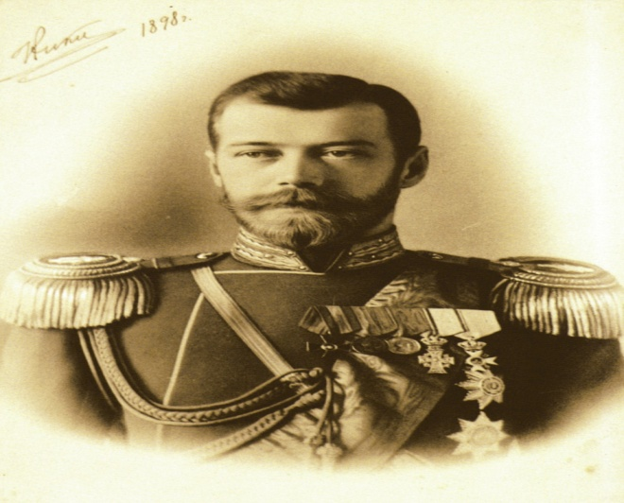
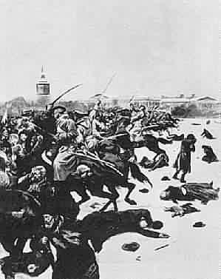
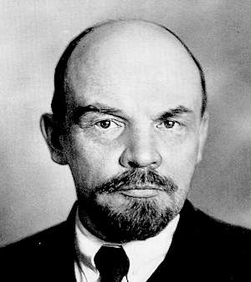
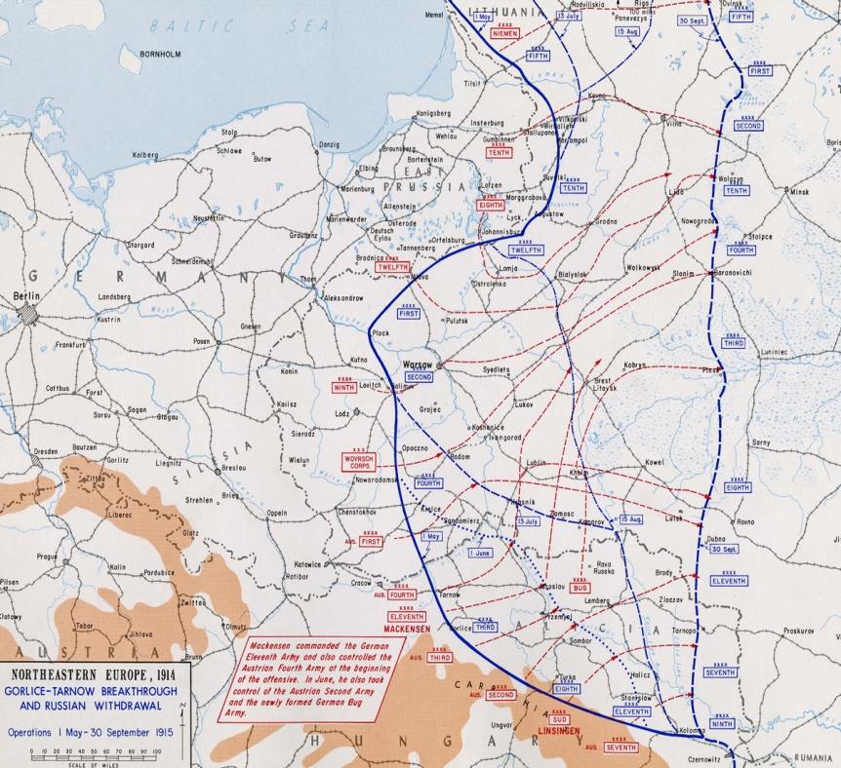
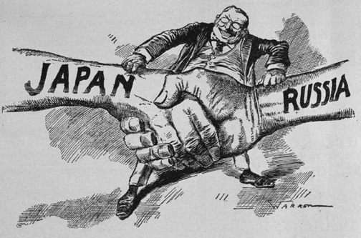
Causes of the Russian Revolution
Czar Nicholas II
Vladimir Lenin

Slide 2
Causes
The Russo-Japanese war (1904-05)
The Bloody Sunday Massacre (1905)
Absolute Rule (Romanov Dynasty)
Social injustice (SERFDOM)
Marxist-Leninism/Communism (Vladimir Lenin)
WWI (1914-1917)

Slide 3
The Russo-Japanese War & Bloody Sunday (1904-05)
Russia never recovered its losses from the Russo Japanese War (Manchuria, Korea, Port Arthur, Baltic & Pacific Fleet )
Workers & peasants marched in protest on the Winter Palace of Czar Nicholas II during February 1905 and were massacred by the Czar’s police force
The people demanded a Duma (elected parliament) in 1906 but it was soon revoked by the Czar
The Czar never regained the full support of the people

Slide 4
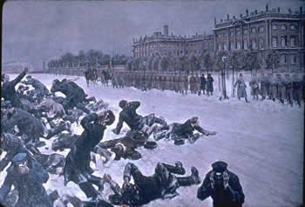
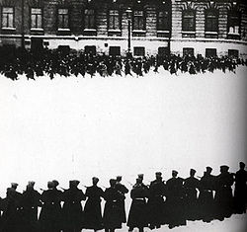
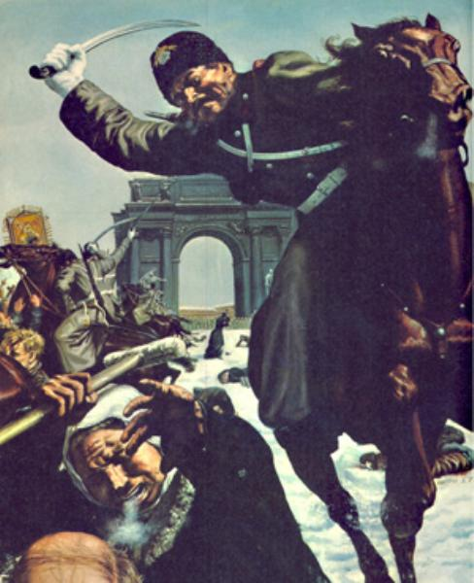
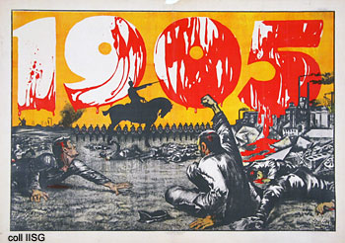
Bloody Sunday

Slide 5
Absolute Rule & Social Injustice
Czar Nicholas II used harsh control over his people to keep them repressed
No individual rights, voting abilities or freedom to travel was allowed for peasants (Absolutism)
Peasants (serfs) were bound to the land, heavily taxed, uneducated & poor

Slide 6
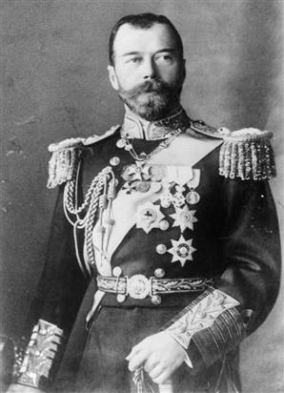
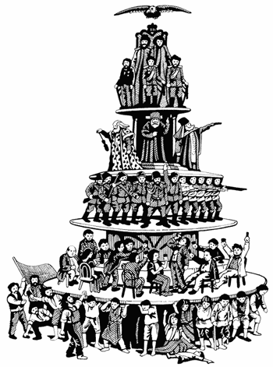
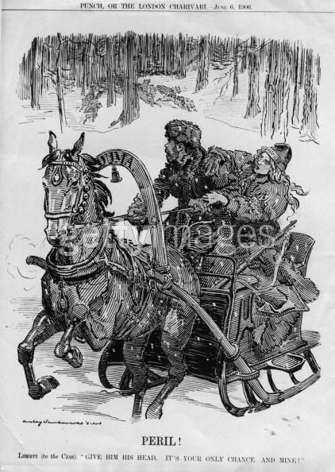
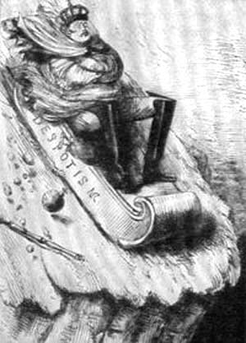
The Russian Social Order
Political Cartoons do not favor the Czar

Slide 7
Lenin & Communism
Vladimir Ilyich Lenin was exiled by the Czar for his revolutionary Communist ideas (inspired by Karl Marx)
Lenin led a small group of Socialist revolutionaries (Bolsheviks) to attempt to overthrow the Czar & absolutism in Russia
Lenin’s promise of “Land, Peace & Bread” appealed to the serfs & workers of Russia

Slide 8
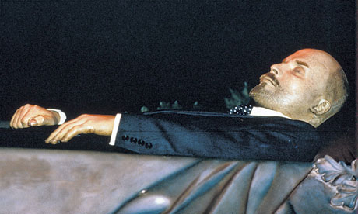
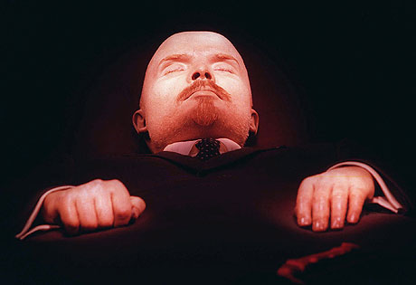
The Russian People LOVE Lenin! (His body is ON DISPLAY permanently in a glass coffin in Moscow!)

Slide 9
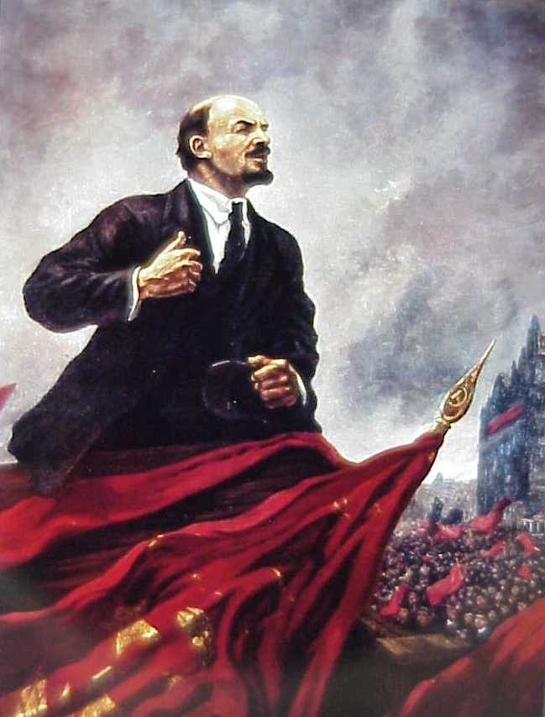
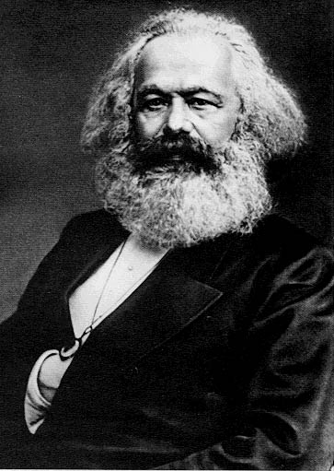

Slide 10
World War I
Russia’s involvement in WWI as an ally of Serbia dragged them into conflict with Germany & A-H
Russia’s lack of industry, railroads and modern weaponry led to huge losses of men & territory (5 million casualties by 1916)
Workers and peasants on the home front suffered from lack of food, fuel and medical care
90,000 workers went on strike in Moscow & St. Petersburg and demanded that the Czar resign

Slide 11
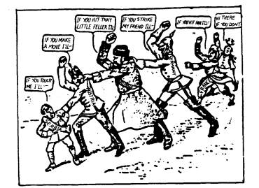
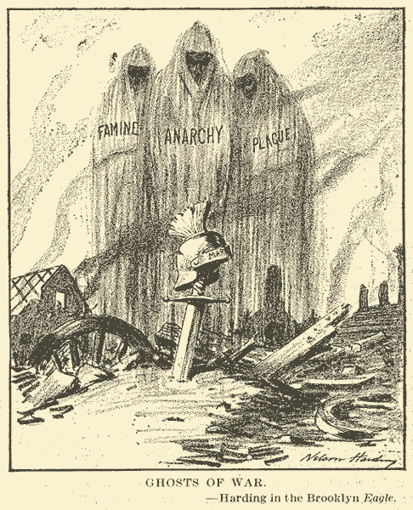
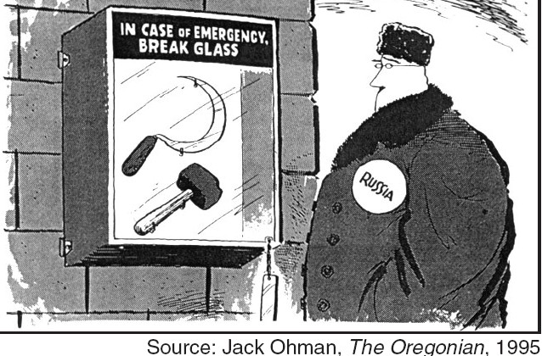

Slide 12
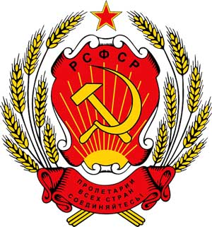
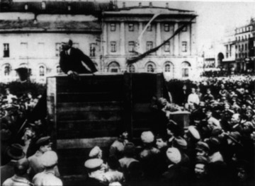
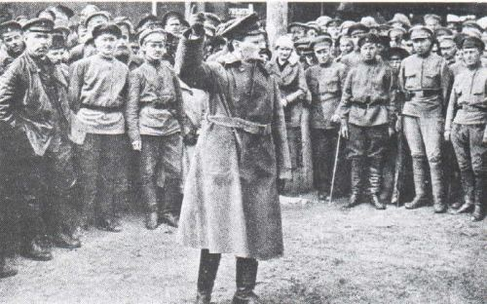
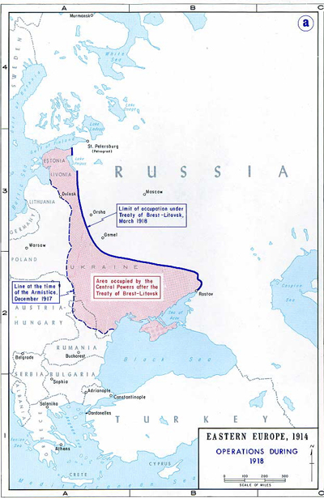
Effects of the Russian Revolution

Slide 13
Effects of the Russian Revolution
March 1917 Revolution-(February by Russian calendar)
Provisional Government takes over (March, 1917)
Bolsheviks under Lenin overthrow Provisional Government-November 1917 Revolution (October by Russian calendar)
Lenin ends WWI with Germany (Treaty of Brest-Litovsk)
Russian Civil War (1918-1921) Reds vs. Whites
The USSR (Soviet Union) forms

Slide 14
March 1917 Revolution
Over 90,000 workers in St. Petersburg & Moscow strike & riot over bread & fuel shortages
Czar Nicholas II is forced to abdicate (resign his position as Czar) March 15, 1917
The Provisional Government led by Alexander Kerensky takes control of Russia (March, 1917)
The Provisional Government continues to fight (& suffer huge losses) in WWI
The Provisional Government exiles the Czar & his family to Siberia

Slide 15
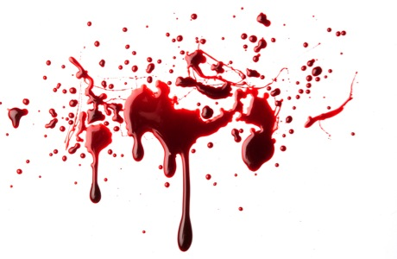
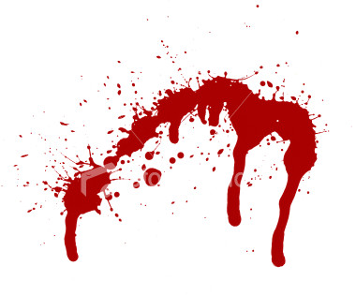
The November Revolution 1917
Lenin violently overthrows the Provisional Government in November, 1917 (October in Russian calendar)
Lenin institutes Socialism in St. Petersburg & Moscow and calls for the execution of the Czar & his family in Ekaterinburg (July, 1918)
Lenin creates “War Communism” and the NEP (New Economic Policy) to fix Russia’s failing economy

Slide 16
Russia Leaves WWI
Lenin immediately makes peace with Germany (Treaty of Brest-Litovsk)
“Land, Peace & Bread” are used to attract peasants and workers to the Bolshevik party
Russia gives up vast tracts of land to Germany in exchange for ending war on the Eastern Front
Russia’s former possessions will be granted self-determination as a result of Allied victory over Germany

Slide 17
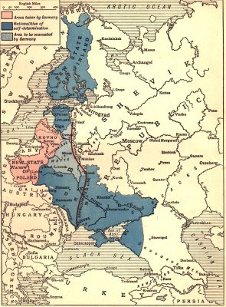
Mapping the Treaty of Brest-Litovsk
Germany gets all of this territory from the Treaty

Slide 18
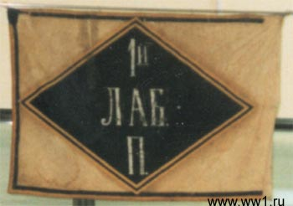
The Russian Civil War
The “Whites” vs. The “Reds” (1918-1921)
The Czar’s supporters, a.k.a. “The Whites” (Generals, Admirals, WWI Allies) attempt to regain control of Russia & overthrow the Bolsheviks
The Red Army led by Leon Trotsky maintain control over key cities (Petersburg & Moscow)
The Whites although better supplied are disorganized & poorly commanded
The Red Army defeats the Whites and maintains control over Soviet Russia

Slide 19
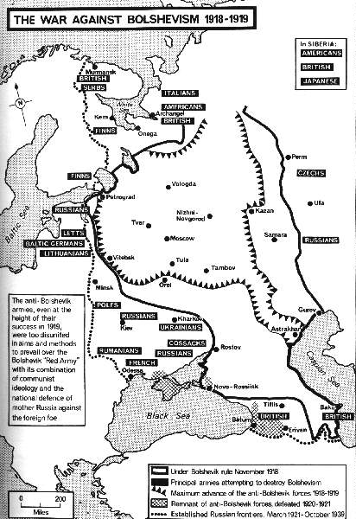
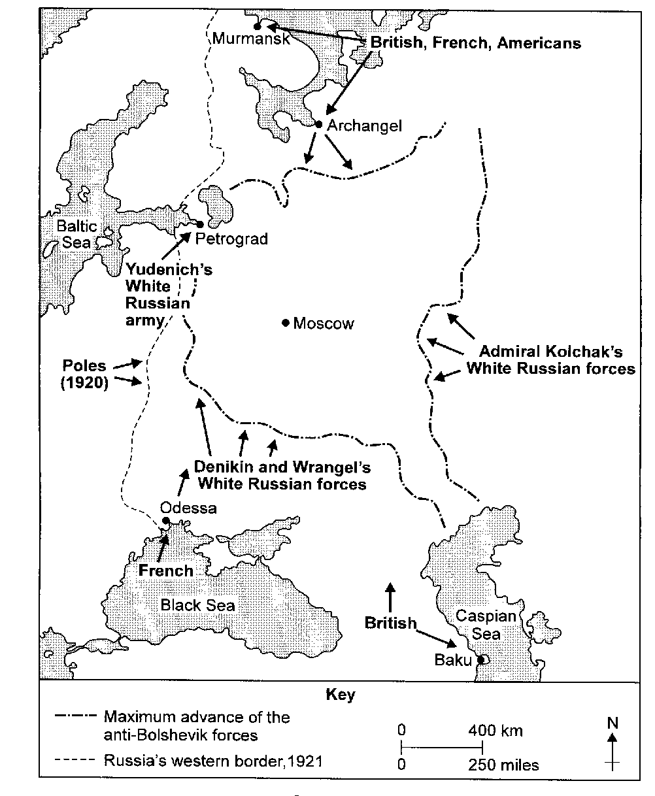
The Russian Civil War (1918-1921)

Slide 20
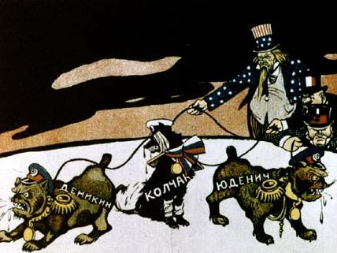
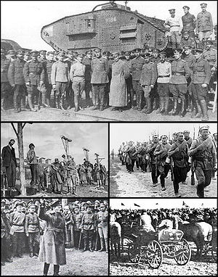
Images of the Civil War
Who is holding back the “dogs of war”?
vs.
The Whites
The Reds

Slide 21
The USSR Forms
After the Civil War ended in 1921, Lenin established the Union of Soviet Socialist Republics (USSR) in 1922 under Communist rule
Lenin repaired the economy by mixing elements of Capitalism (free market) for the peasants with Command economics (government ownership) of heavy industries like coal, steel, ships, electricity, weapons (The NEP-New Economic Policy)
The USSR is governed as a series of Soviets (local councils of workers, soldiers & peasants)
Economic recovery begins under Lenin, unfortunately he dies in 1924 before his plans take full effect

Slide 22
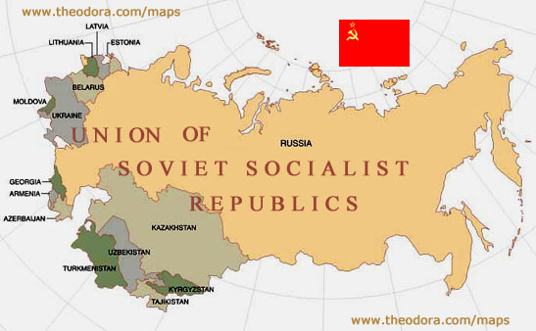
The USSR

