Slide 1
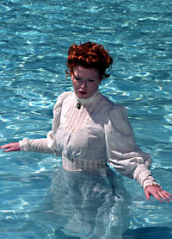
The Awakening

Slide 2
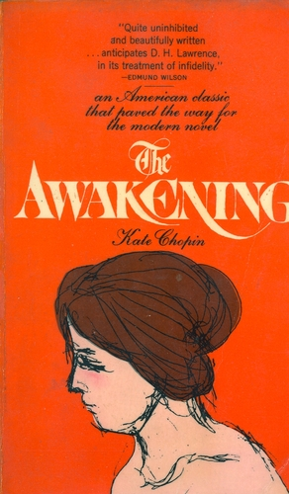
Constructing the Introduction
THE DECLARATIVE THESIS

Slide 3
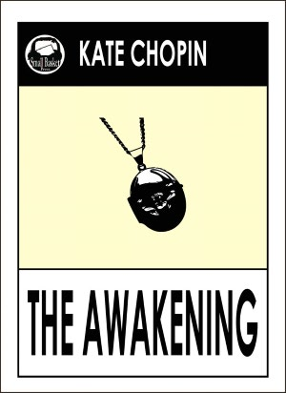
Declarative Thesis
By juxtaposing the land and the sea, Chopin inverts traditional gender roles in order to create a feminist discourse. What was once the silenced voice of women becomes the revisionist narrative of feminine power.

Slide 4
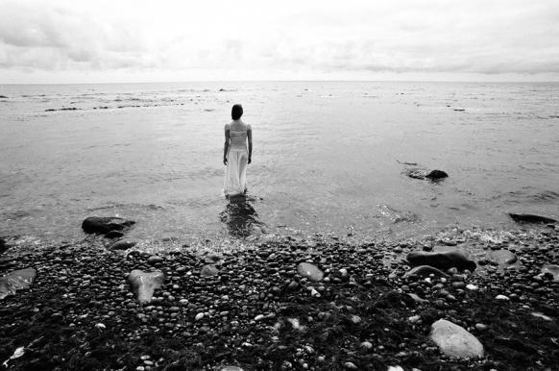
Declarative Thesis
Chopin has her protagonist die as a Christ-like martyr in order to create the birth of the feminist movement. By juxtaposing Edna to Jesus, the text of the bible is revised to include a more prominent space for women.

Slide 5
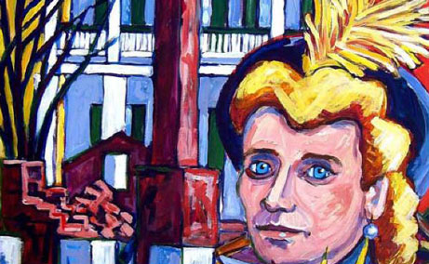
Declarative Thesis
The cult of domesticity is eradicated in The Awakening in order to create the genesis of the feminist movement. What was once the squabble of “bird talk” becomes the powerful voice of a collective feminine reasoning.

Slide 6
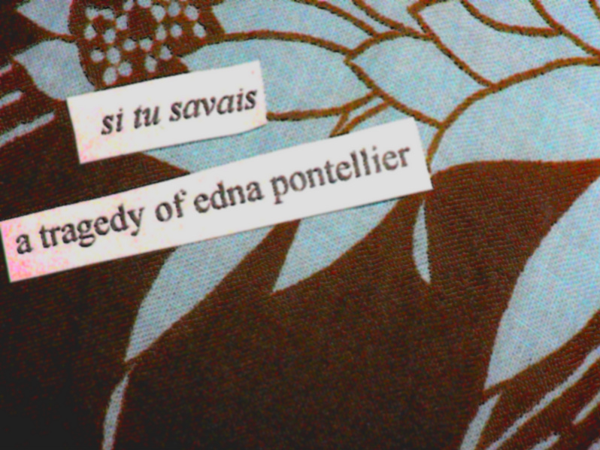
Declarative Thesis
Edna becomes a symbol for all women by the end of the story. She kills herself but not really – she is the mother of feminism. There are a lot of binaries that get inverted throughout the novella.

Slide 7
Revisiting the Syllogistic Method
1st Premise: Statement that contains an argument OR a literary term
2nd Premise: Textual Support
Conclusion: Textual Analysis

Slide 8
Chopin juxtaposes feminine discourse to “bird talk” early in the story in order to show the oppressive confines of the cult of domesticity. It is significant that her narrative begins with “a green and yellow parrot [hanging] in a cage outside the door, [which] kept repeating over and over: Allez vous-en! Sapristi! That’s all right” (1). These opening remarks become an invocation, a desperate plea for women to “Get out! Get out, gosh darn it!” Women in this era are viewed as social “chattering and whistling birds” that are the mere property of their husbands. They “bustle” about their trivial social engagements “in a high key.” In these opening remarks, Chopin correlates women to birds in an effort to play with the notion that “birds of a feather flock together.” All the women in this society dress identically – always “clad in white with elbow sleeves.” As such, these women “whistle” the common discourse of “bird talk” – they are caged creatures that “jabber” the same notes over and over again. Despite this polarizing dichotomy between men and women in this opening chapter, Chopin gives indications that Edna is already beginning to break free from the cult of domesticity – she swims in the sea without her wedding band – an image that comes full circle for it is there that she dies a martyr for the feminist movement.

Slide 9
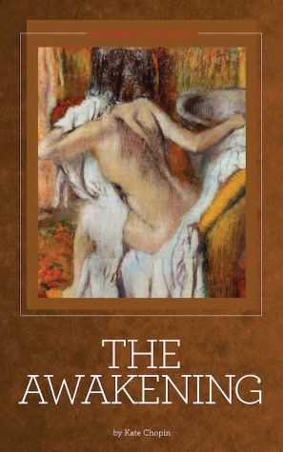
It Comes Down to Your 1st Premises
Edna is juxtaposed to a caged bird.
Edna is juxtaposed to a caged bird in order to show her inevitable flight away from the cult of domesticity.
In juxtaposing Edna to Christ, we see that she dies a martyr for the feminist cause.
Early in the story, Edna plays the part of the good wife.
Early in the story, Edna can only speak the language of domesticity, but by the end of the story she becomes fluent in the language of feminism .

Slide 10
What Are Your Targets?
1st premises that contain literary arguments
Provide sufficient textual support to fully prove your argument
Embed Your Quotes
Lots of Textual Analysis

Slide 11
Student Sample
The imagery in chapter VI foreshadows Edna’s martyrdom. She sits by the edge of the sea and “abandons herself to tears” – like a child in her infancy, she struggles to find the words for what she cannot express. Her feminist sentiments are allowing her to “realize her position in the universe as a human being,” but the “ponderous weight of this wisdom” is too much to “vouchsafe to any woman.” Chopin is ironically highlighting the preconceived bias of the era – that women are intellectually inferior to man and cannot process the “wisdom of the Holy Ghost.” What is interesting about this chapter is that the sea is trying to speak, just as Edna is trying to give voice to her objections with the cult of domesticity. The sea is given a “voice” that “whispers, clamors, murmurs, and invites the [young] soul” to form the words of Edna’s protest.

