Slide 1
The Rhetoric of Race
Writing Workshop

Slide 2
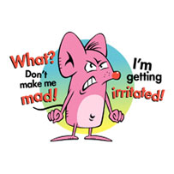
Dang snaps … How and the heck do I get the Introductory Cheese?
Avoid the Zaps!!!

Slide 3
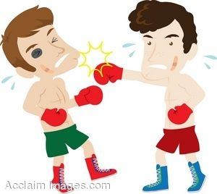
Declarative Thesis
Come Out Punching!!!

Slide 4
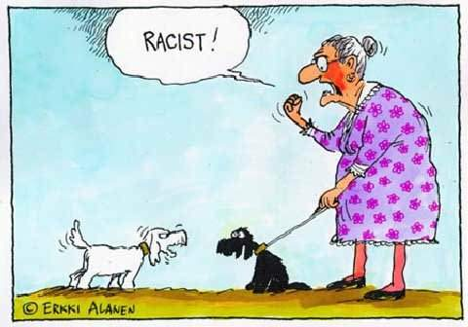
Introduction: Sample #1
Representations of “Blackness” in popular American sitcoms invert the precepts that underlie the narrative structure of traditional minstrel shows. African-American characters assume characteristics that are indicatively Caucasian – especially in terms of discourse and values centered upon academics and economic standing – but these depictions reveal a latent racism that still roots American culture in the damning ideologies of Jim Crow.

Slide 5
Introduction: Sample #2
Media representations of racial harmony bridge a cultural divide that has systemically polarized Americans. Discordant relations unfortunately provide a marred backdrop for America’s story, yet recent depictions of race have drastically altered this historical narrative.

Slide 6
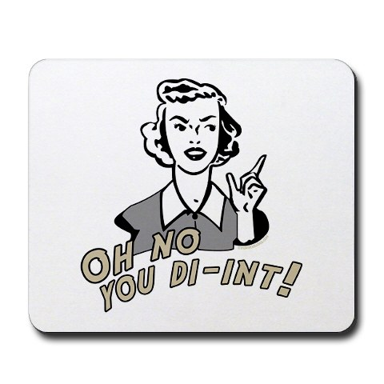
Introduction: Sample #3
There are some good and bad things in the episodes I saw of The Cosby Show, Fresh Prince of Bel-air, and My Wife and Kids. While some aspects can be construed as being blatantly racist, I think that the creators of these sitcoms did so unintentionally. Their hearts were in the right spot, but their guns might have misfired.

Slide 7
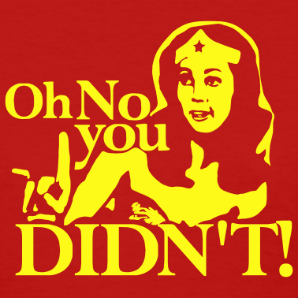
Zaps to Avoid
Be Assertive
Develop a Clear Position
Precise/Concise/Exact Language
No need to list

Slide 8
Introduction: Sample #4
What is cloaked as humor is actually a thinly veiled manifestation of a latent racial element that lies silent within American social discourse. The intentions of recent Black sitcoms are unquestionably pure, but these comedic effects unwittingly reinforce damning racial misconceptions.

Slide 9
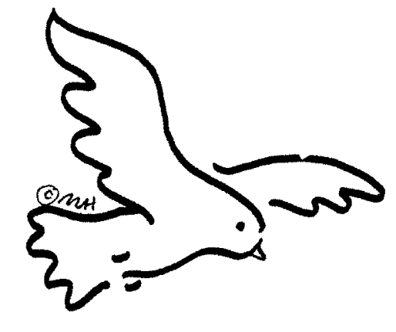
Student Sample: Thesis
The cultural sensitivity that roots from the historical treatment and perception of blacks leaves the present media at a loss. Attempts to balance the incorporation of black culture and avoid a racist representation results in a misleading portrayal that tends to follow the social stereotypes present in modern society.

Slide 10
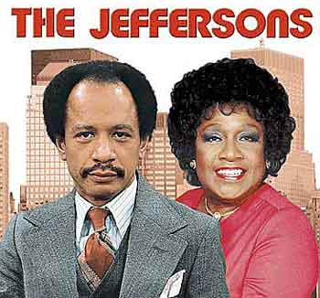
Student Sample: Thesis
The roots of modern black poverty lie in the stereotype of race being associated with success. This leads to a social construct for the black community that in order to be successful, one must ‘denounce’ their race and ‘act white’. This concept is without question reinforced in modern black sitcoms.

Slide 11
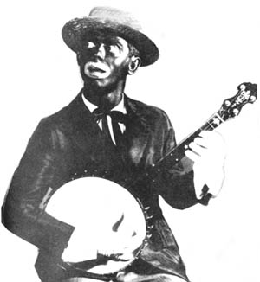
Student Sample: Thesis
African-Americans have historically been portrayed comically in blackface, utilizing stereotypical racial caricatures to transmit ideals of ‘blackness’ and shape public images of ‘black life’ on an unconscious level. Contemporary sources attempt to alter these images through various depictions of family structure, by portraying affluent and intellectual African-American characters, thus inversely construing the typical blackface into whiteface.

Slide 12
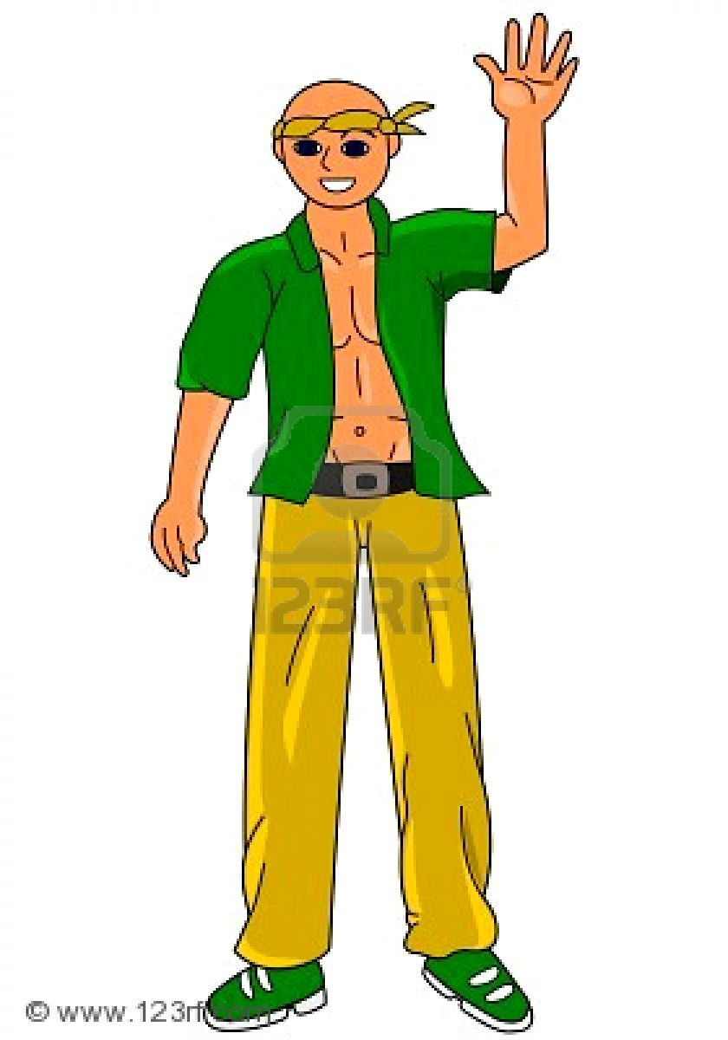
Hold on their chief, how do I do that synthesizing stuff in my body paragraphs?

Slide 13
Body Paragraph: Student Sample
Racial stereotypes that predate abolition are still influencing the current views of black Americans. The first creation of an over-branching description of the black people was most likely developed to justify the buying and selling of slaves. By forcing themselves to see Africans as more “half-human and half-animal” (Blackface Stereotype, p.5) than actual people, blacks kept as property seemed more acceptable to society and to their consciousness. As a result of this wild imagery, Blacks were viewed to be illiterate, unintelligent, plow horses. The perfect cotton-picking slave would have to be “more body than mind” (“Acting White”, p.337), slaves feigned ignorance even if they did manage to receive literacy education “in a world where a smart Black man [risked] punishment” (“Acting White”, p.338). The illiteracy slowly formed into a rock solid stereotype featured in Blackface Minstrel shows who spoke in imperfect English, singing “First on de heel tap, den on de toe” (Wiki: Blackface, p.1). The notion of slower intellectual processing in colored individuals, particularly males, is still incredibly common. The evidence is in the definitions of the English language. The term “ghetto” has multiple meanings. As an adjective, its listed meanings include “Black” as well as “actions that seem to go against basic home training and common sense… [and] used to describe something with inferior status or limited opportunity” (Ghetto Nation, p.1) … OVER

Slide 14
Student Sample #1 Continued
Compounded on that is the overwhelming amount of intelligent characters on television shows and in movies that are white. In the newer releases, such as “Shrek 3”, “High School Musical”, and many others, the main “nerd” in the program is white, while the black character is the runner-up, the second best, or the less intelligent. This media reveals the inner thoughts and views of the society as a whole, which is a shocking parallel to the original beliefs of white supremacy and black stupidity. Another echoed description is that of the black women’s sexual nature. In pictorial representations and text, the black women is often “presented naked or scantily dressed, looking as if intoxicated by sexual desire: she is always the girlfriend or the other wife” (Blackface Stereotype, p. 4). Another aspect associated with modern “Ghetto” is babydaddies. The concept of wanting a baby with someone and that being the end of the relationship creates an atmosphere about black women of wanting sex and nothing else out of a relationship. This idea has clearly not changed much from its precursor. It also goes hand in hand with the stereotype that Black people are savage and wild. In one picture by David Levinthal, a black man is depicted with ‘blood-red lips and tongue… and the right eye, … in shocking contrast to the left, is shut” (Blackface Stereotype, p. 2). The colors and lack of eye represents the savage nature of the man. Reflecting on the previous statement regarding the lack of intellect stereotypically present in the modern black, there is little left for him in the way of careers. This turns many toward the more masculine pursuits of drugs, violence and crime, the modern savage. All the behaviors and characteristics attributed to the modern black stemmed from, and still mimic, the original views around the black culture.

Slide 15
Student Sample #2
Historical analysis of African Americans promotes race as a culturally sensitive topic in America. In the past, blacks in the Unites States have gone through much discrimination and change, which – in the subconscious mind of the American – generally places them at the bottom of the social and economic hierarchy of society. Past occurrences that have led to this skewed social perspective are ideas much like the myth of blackface. This fantasy “posits whiteness as the norm” and portrays blacks as a symbol of “social imperfection, inferiority, and mimicry that is placed in isolation with an absent whiteness as its ideal opposite.” Blacks have been seen as inferior to whites many times throughout history, and blackface represents this perception. These types of myths are the basis of the current black stereotype of social inferiority. Along with historical treatment, this perspective has created an idea that is still in the subconscious mind of Americans. The cause of this is that “the complexity of modern existence, and the global reach of temporary society, made it impossible for people to make sense of the world on the basis of firsthand knowledge.” The reinforcement that the opinions and experiences of others are necessary for one to create their own perception further shows the roots of the stereotypes in society … (OVER)

Slide 16
Sample #2 Continued
The social classification of blacks in the past has become the basis for modern civilization and created an unconscious condescending attitude towards the African American race. The social inequality based on racial differences that plagues society has caused the topic of race in general to become a very sensitive one in culture. Even from very young ages, white children are taught that differentiating people based on race is impolite and unacceptable. Paul Hardin of UNC explains that he is “afraid of separatism” in his schools, which roots from the sensitivity that has been created through past occurrences. Not only does society struggle to balance sensitivity and black culture as it exists today, but so does the media in its portrayal of the modern black family. When taking in remarks such as Bill Cosby’s addressing how he is “tired of the car crashes, the hookers with the Black pimps,” they become even more sensitive in their portrayal of African Americans on television. This cultural sensitivity is evident in television shows such as “The Fresh Prince of Bel Air” and “The Cosby Show.” In both shows, the families are very wealthy and are better off than a very large percentage of the entire country – not just blacks. This representation is a result of cultural sensitivity and the fear that portraying reality will come off as racist. The media fears the representation of any reality that may follow the stereotype that in ingrained into the minds of Americans. Past stereotypes has caused race to be an awkward topic for white Americans and has left the media in a position of sensitivity that is fearful to portray any general reality.

Slide 17
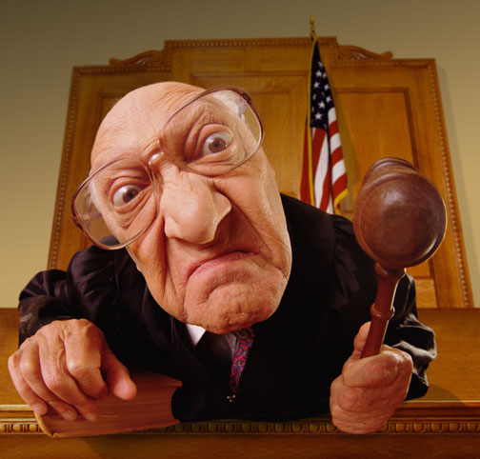
You Be The Judge
How does your thesis stack up to these?

Slide 18
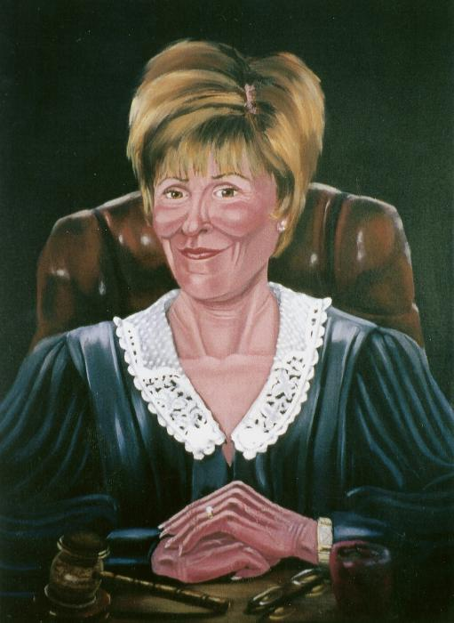
Note: The Next 3 Introductions
Situate the Writer in the Mid to
Upper 90s

Slide 19
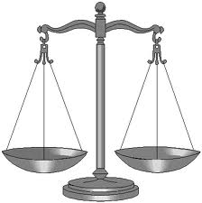
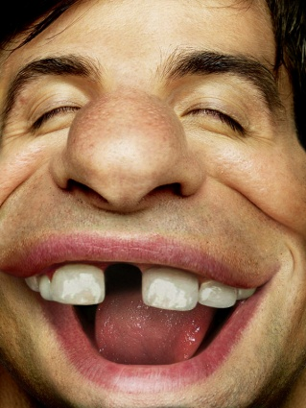
Student Sample: Introduction
Through the media, the message is sent that in order to break the glass ceiling, Blacks must invert blackface. Those who maintain “black” behavioral traits are portrayed as dim, comical, and ultimately unsuccessful - leading to racism and resentment on the part of both skin colors.
Compare this to your thesis statement. Equal, less, more? And most importantly, why?

Slide 20
Student Sample: Introduction
Though attempting to display African Americans in a positive light, media portrayals are often deleterious (Note how concise the thesis is … the punch … the declaration). While making an effort to demonstrate constructive family values, sitcoms unconsciously hint that white is good and black is bad. They also have a hand in developing negative feelings towards African Americans who aren’t living in such a manner as that shown on television.
Compare to yours!! More than, less than, equal to?

Slide 21
Student Sample: Introduction
Black sitcoms portray a positive message as they help to disprove negative stereotypes that close the gap between races. While some criticize these shows for ignoring prominent issues such as racism, this is an absurd double standard, as white sitcoms are rarely, if ever, held responsible for inaccurate portrayals of real life.
Compare
How concise & accurate is your phrasing?
How sophisticated and original is your thesis?
Is your language assertive and confident?

Slide 22
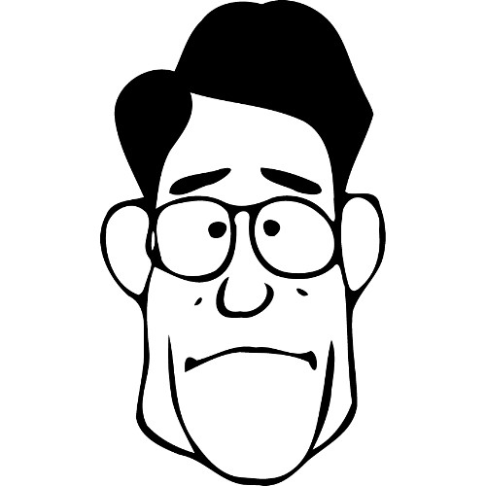
Concerning Synthesis …
Re-read your first syllogism. Did you …
Write a concise, clear, confident 1st premise?
Incorporate textual support and analysis that wove together specific scenes from the sitcoms as well as draw liberally from the articles?

Slide 23
1st Premises: Studs
Although many believe that the racial gap has been curtailed, racial inequities are perpetuated in contemporary Black sitcoms. (Be concise … Vocabulary)
Within the Black community, the ever-present stereotypes cause many viewers to correlate success with “selling out” or “acting white.” (Like this sample, you must argue!!! You also need to be exact with your phrasing)
African Americans who display stereotypical “Black” behavioral traits are cast as stupid, entertaining, and unsuccessful. (This argues and is worded very precisely)

Slide 24
1st Premises: Studs
Situation comedies present a skewed image of black society to glaze over racial strife.
A reverse stereotype does not mean that there has been an elimination of white racial tension toward blacks.
When race is a theme of a television program, it is more likely to widen the divide between blacks and whites than remove it.
The commonly held view that the only successful African Americans are those who “act white” has led to discrimination against successful Blacks by members of their own race.

Slide 25
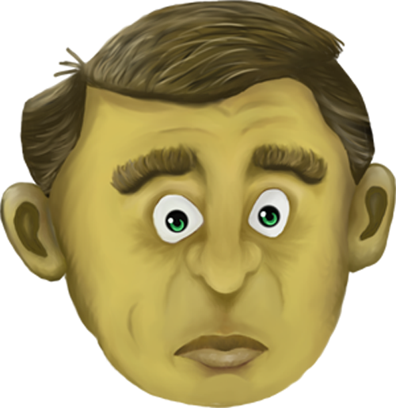
Critiquing Your 1st Premises
To Consider
Are your 1st premises concise?
Are you arguing or reporting? You MUST argue!!
Is your phrasing exact and “academic” in tone?

Slide 26
Student Sample: The Art of Synthesis
According to the media, only by inverting blackface and “acting white,” can African Americans become successful. (This is an arguable, well-phrased, concise 1st premise) The blackface tradition stems from minstrel shows in which white people used make-up to appear black. However, in contemporary black sitcoms blackface has been inverted, and black characters “act white.” Much of society deems this to be tacitly understood and an acceptable social norm, which implies that those who assume this inversion become more successful than their counterparts. For example, The Cosby Show has been described as portraying “a too white image of black culture” (Dalinger). (Cool … some textual support … but look how this writer weaves this into other articles as well as the episodes we saw)Despite this perception, the characters are all very successful (OVER)

Slide 27
Synthesis Sample Continued
Mr. Huxtable is a doctor; Mrs. Huxtable is a lawyer – and all
of the children do well in school. They are unquestionably upper-middle class, something considered to be a mark of successful careers and fulfilling lives. The same is true in The Fresh Prince of Bel-Air. Carlton acts very white, especially in school. Despite being socially awkward, Carlton is very successful academically. Another example (look at how the sitcoms are synthesized back into the articles … You’re looking at something really good, kids!!) of this is in the desired “Black Cultural Center” at the university of North Carolina. This request was protested vehemently by many. Jerome M. Culp Jr. interprets this hostile response to the proposed cultural center as a belief that “the only good [black] students effectively have to put on white face” (681). Culp re-emphasizes this by stating how a “requirement of black assimilation is akin to a requirement that black people put on white face” (670). Another symbol if this “acting white” is (OVER)

Slide 28
… the use of language considered to be “white.” A common misconception , according to Cora Daniels, is the “confusion of ghetto for black” (42). This includes “ghettospeak,” including both vulgar words and incorrect grammar. Bill Cosby also references this “ghettospeak” in his Pound Cake Speech at an NAACP function. He inquires hypothetically as to how people are supposed to be respected when it’s nearly impossible (You getting it? Synthesis requires a woven tapestry of not just the articles separately and alone, or just the episodes independently, but the articles and sitcoms together) to understand how they speak. All the while, he speaks in a characteristically “white” fashion – as do his characters on The Cosby Show do. Bill Cosby is definitely considered successful, thus the fact that he is making … (And so on) …

Slide 29
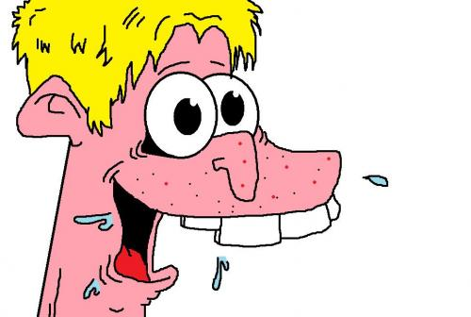
Synthesis: Self-Critique
As You Strive to Become a Better Writer
Are you synthesizing correctly?
Are you embedding your quotes?
3. Are you keeping the “promise” of the 1st premise?
4. What can you specifically do to improve ?

Slide 30
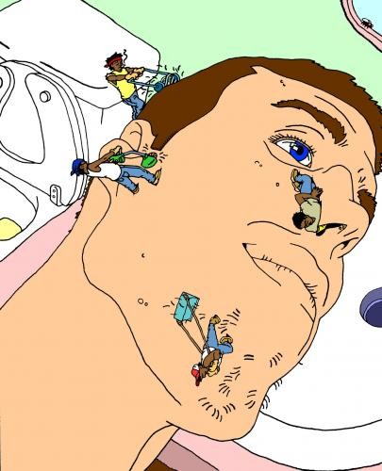
Special Message to Those Submitting the Essay Late
To begin, let me remind you that this is a college class. If you were in my Fisher or MCC class, you would have just earned a fat “F” in the course. Due dates aren’t an option!!

Slide 31
Special Message to Those Submitting the Essay Late
I’ve spent 9 hours of my vacation coaching and judging your writing b/c I firmly believe that your vacation should serve as a reprieve from school work. For those of you who chose to not meet the due date, you’re responsible for coaching and judging your essay prior to submitting it. Stick to the rubric and be critical of your work.

