Slide 1
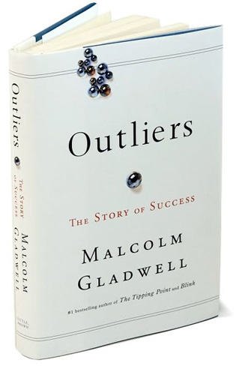
Outliers Writing Workshop

Slide 2
Student Sample: Introduction
Talent is an inherent disposition that is required to achieve a certain level of success, which cannot be acquired simply by practicing. Though practice inevitably refines a skill, the mastery of an activity cannot be achieved without the presence of natural ability.

Slide 3
Student Sample: Introduction
Opportunity does not determine success, because without innate talent and practice, these chances will never be fully taken advantage of. A person’s congenital advantage can never win in a world based on a meritocracy.

Slide 4
Student Sample: Introduction
Throughout life, success directly correlates with the surrounding society. This environment, as well as its restrictions, can be the sole reason for a person’s trek towards success.

Slide 5
Student Sample: Introduction
Success is essentially living up to the standards of what others consider it to be. Working towards something seems pointless if the majority of society does not label it as a success. This is because success is relative, making it a conformation of what society wants one to become.

Slide 6
Synthesis
Success is nothing more than a societal mechanism that separates the haves from the have-nots. To be successful is to be seen as so by the general public – success is fabricated by expectation. In reference to success, Malcolm Gladwell claims that “It makes a difference where and when we grew up.” This is because the society we grow up in is what creates our expectations. “The culture we belong to” does not always make success more attainable or visa versa, but it is rather what sets the bar for what is considered “successful.” This perspective is what fabricates the general expectation of that community, setting the standard of success for its inhabitants …

Slide 7
The creation of these expectations can be seen in Nowlan’s comparison of “The two tiers – Bluffs and Bottoms.” He describes the “psychological and cultural distance that those on the Bluffs have clearly tried to maintain.” People on the Bluffs have grown up with the expectation of a successful society to be one of their caliber. The lifestyle that they are accustomed to made their definition of success merely a construct of their own society. They intend on keeping this “distance” from the “bottoms” because their expectation for a successful community caused them to see these people as inferior.

Slide 8
Synthesis
1st Premise = Original Argument … Sub-topic Pertaining to the Thesis
2nd Premise = Textual Support From At Least 2 Different Sources
Conclusion = Textual Analysis

Slide 9
Synthesis
Hours of practice can only be useful when applied to a person with a gift. In Outliers, Malcolm Gladwell reasons that "the ten-thousand rule [is] a general rule of success" (Gladwell 47), and therefore anyone who practices something, like a sport or an instrument, will become a master after 10,000 hours. What he neglects to consider is that those people who tend to devote thousands of hours to an activity are those people who learned early on that they possessed a certain knack for it. No athletes or musicians would spend years of their lives obsessing over one thing if they didn’t believe they had potential. And that potential comes directly from the gifts they have even as children. Gladwell himself never seems sure on the topic, often citing examples that are dichotomous with his theories. As he used college quarterback Daniel Chase as an example of a promising NFL prospect due to his experience on the field, he contradicted himself by acknowledging "his backup… [who] had thrown a total of twenty-six passes… in his four years at Missouri… would end up as a better professional quarterback than Daniel" (Gladwell 4).

Slide 10
Surely, by Gladwell's standards, the less-experienced player could never surpass the actual "master." But Patton has undeniable talent in certain areas of football that uniquely qualified him for the NFL, and no matter how much Chase practices, he can't attain that level of aptitude if he wasn't born with it. Gladwell tries to assert that "extraordinary achievement is less about talent than it is about opportunity" (Gladwell 76). But wouldn't it be safe to say that opportunities present themselves all the time, and only the talented at young ages have the ability and passion to seize them. Truly talented people tend to seek out opportunities, instead of waiting for them to appear. When Chris Langan was able "to get through Principia Mathematica at sixteen" (Gladwell 90), it wasn't because he practiced thinking for 10,000 hours. It wasn't because he stumbled upon an opportunity. It was because he was born with an unprecedented disposition to absorb information and contemplate on a much higher level than his peers, immediately distinguishing himself as a brilliant talent destined for success.

