Slide 1
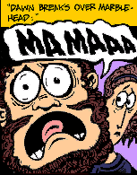
Oedipus the King
Writing Workshop

Slide 2
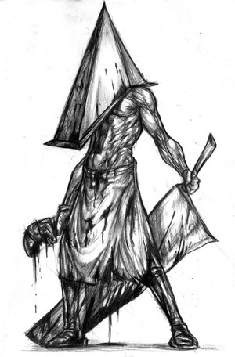
Declarative Thesis
START WITH YOUR THESIS … YOUR MAIN POINT

Slide 3
Sample Declarative Thesis
Through dramatic irony and a binary inversion, Sophocles resolves the Riddle of the Sphinx to illustrate Oedipus’ plight. In blindness one finds darkness, but In Oedipus’ case, his demise provides the light of his self-realization.

Slide 4
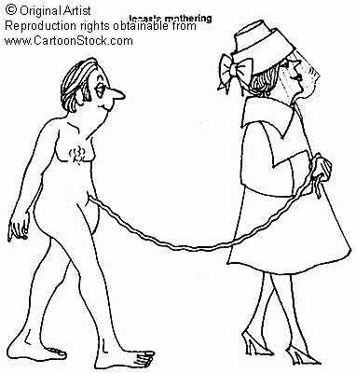
Sample Declarative Thesis
Sophocles inverts the binary of light and darkness to reveal Oedipus’ ironic fate. With his sight intact, Oedipus is in the proverbial dark – he is unable to see the role he plays within the context of the oracle. It is only through blindness is he able to see the “light” of his ways.

Slide 5
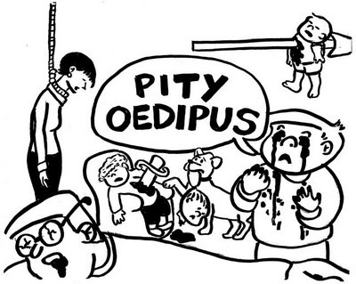
Sample Declarative Thesis
Knowledge is typically associated with lightness, while ignorance is linked to darkness, but Sophocles inverts this paradigm to fuel the dramatic irony within his play. It is only through this dark blindness that Oedipus begins to see the light of his true character.

Slide 6
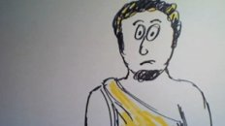
Sample Introduction
The use of dramatic irony and a climactic binary inversion create the mystery, and solution, of Oedipus the King. Sophocles’ light and dark, and sight and blind binaries are analogous to the mystery and knowledge Oedipus faces. The final scene – where blindness and understanding are united – resolves the agonizing dichotomy of sight and confusion.

Slide 7
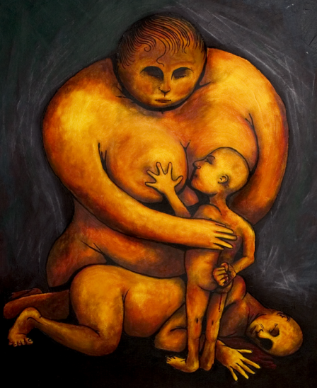
Sample Introduction
Sophocles embeds his “Oedipus the King” in doubt with regard to the true paternity of Oedipus and the validity of oracles. However, the revelation of truth is far from the crux of the work; through situational irony, the audience is already aware of the outcome. It is the process of dramatic realization, the play and inversion of light and dark, knowledge and ignorance, that builds on the meaning of the play and gives life to its plot.

Slide 8
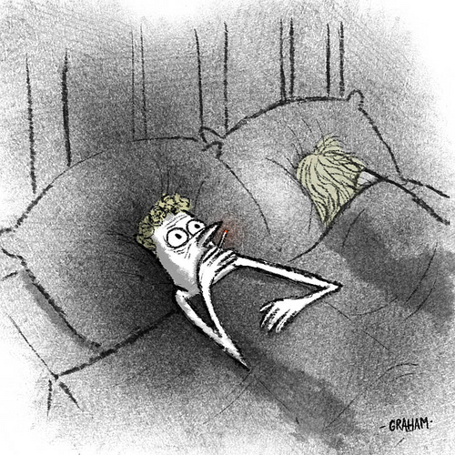
Revisiting the Syllogistic Method
1st Premise: Statement that contains an argument OR a literary term
2nd Premise: Textual Support
Conclusion: Textual Analysis

Slide 9
The prevailing binary of light and blindness, sight and darkness, emerges in one of the very first scenes and continues throughout the play. In the beginning, Oedipus questions Teiresias about a prophecy that claims Oedipus will slay his father and wed his mother. Dissatisfied with Teiresias’ answer that points the finger of blame towards the king, Oedipus turns toward the prophet and claims him blind, cloaked in darkness, incapable of seeing the truth. At the same time, he relates to himself as enlightened and knowledgeable, presenting his mastery of the Sphinx riddle as evidence of his greatness. But as the audience is already aware, it is Oedipus who is in the dark, in denial of the possibility that he could be the reason for the plague upon his city. The binary that develops at the start of the play forms the foundation for the rest of the play as Oedipus struggles to break through into the light and discover his true origins. It presents a convenient opportunity to elaborate on characterization and embellish the plot of the story.

Slide 10
What Are Your Targets?
1st premises that are concise and argue
Provide sufficient textual support to fully prove your argument
Embed Your Quotes
Lots of Textual Analysis

Slide 11
At the end of the play, Sophocles inverts this binary, giving new meaning to the qualities of darkness and sight. As Oedipus mourns the somber death of his wife and mother, he arrives at the conclusion that as long as he has his sight, he will be forever trapped in the world of darkness, unable to escape from the constant reminder of his faults. Gouging out his own eyes with the broach of his wife, Jocasta, Oedipus reverses the juxtaposition of knowledge and ignorance, plunging into the realm of darkness, finally surrendering to the “light”. This climatic portion of the play is the summit of all the previously established drama and irony. As the audience grieves at the inevitable tragedy, it also marvels at the emotional pinnacle developed through the binary and its inversion.

Slide 12
Excellent Student Sample
Sophocles proposes that ignorance leads to immorality through the use of dramatic irony and binary inversion in the epic “Oedipus the king.”

Slide 13
The entire overarching plot of the piece is dramatically ironic. Directly in the opening argument the entire plot, and all the secrets of Oedipus’ history, and his crimes when he “unwillingly slew his father Laius… and espoused the widowed queen,” are revealed. Sophocles uses this irony to create a morally ambiguous character. Although the audience is aware of the atrocities committed by Oedipus, the character of Oedipus himself is in many cases shown to be a righteous person. When Creon returns from the oracle, with advice about how to help Thebes Oedipus allows him to “Speak before all; the burden that I bear is more for these subjects than myself.” In this particular case Oedipus’ dedication to his subjects is apparent. Oedipus is further built as a righteous character when he so willingly agrees to search for Laius’ killer, with the intention to help his “loyal subjects who approve my (Oedipus’) acts.” Given his obvious devotion to his people and to justice, juxtaposition is created between the character himself, and the character the audience expects him to be, knowing full well the crimes he will commit from dramatic irony. The audience is forced to ask itself how such a righteous character could commit such atrocious crimes. Fortunately Sophacles provides the answer to that question through the use of binary inversion.

Slide 14
Parallel binaries are formed between sight and blindness, as well as between knowledge and ignorance. Oedipus, up until the binary inversion had the facility of sight. However up until that point he was also ignorant of his own crimes. On the other hand the blind prophet Teiresias is the one man who could “see(s) eye to eye with our (the Theban people’s) lord Phoebus. Tension is created when Teiresias explains to Oedipus the truth, “Thou art the man, Though the accursed polluter of this land,” and Oedipus rejects it, insulting him in the process, asserting that Teiresias “In ear, wit, eye, in everything art blind.” This tension shows Oedipus’ ignorance. This is the ignorance that causes Oedipus’ moral ambiguity, as it caused him to commit a grievance despite his moral righteousness. These binaries are inverted when Oedipus finally accepts the truth and “struck with his hand uplift his eyes.” By stabbing his own eyes Oedipus inverts the binary of sight and blindness. By accepting his deeds Oedipus inverts the binary of knowledge and ignorance. The significance of this inversion is apparent as it completes the idea that Oedipus only acted amorally when he was ignorant. Oedipus’ anguish as demonstrated by his self-mutilation shows his guilt, which further supports his character’s moral righteousness. Surmising from all of this it is apparent that according to Sophocles ignorance leads to amorality.

Slide 15
Another Student Sample
Sophocles develops binaries between light versus dark and sight versus blindness to depict the dramatic irony of Oedipus’ fate in Oedipus the King. The relationship between sight and knowledge transitions into a binary inversion when Oedipus only realizes the truth behind his relation to the oracle when he causes his own blindness by stabbing his eyes out.

Slide 16
The binary between light versus dark and knowledge versus ignorance develops the characters and their ability to understand the past of Oedipus. While speaking with Tiresias to understand the cause of the plague destroying Thebes, Oedipus states “I will bring it all to light”, meaning that he will literally share the truth behind the cause of the plague with the people of Thebes (11). When considering the binary, “light” refers to the knowledge of Oedipus. At this point, Oedipus is ignorant in the sense that he does not know his past and what will be revealed. After the truth is discovered, Oedipus proclaims “Darkness, dark cloud all around me, enclosing me, unspeakable darkness…I feel the stab of these sharp pains, and with it the memory of my sorrow” (74). Opposite of light, the “darkness” refers to the lack of knowledge or ignorance of Oedipus. In this example, the binary is inverted to exemplify the dramatic irony of Oedipus’ fate. The diction choice of “darkness” is a binary inversion because, at this moment, Oedipus is referring the his “memory” of the truth.

