Slide 1
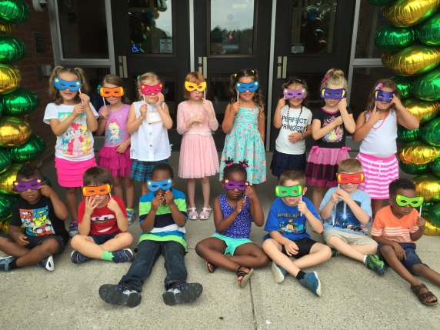
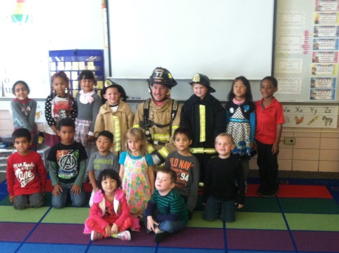
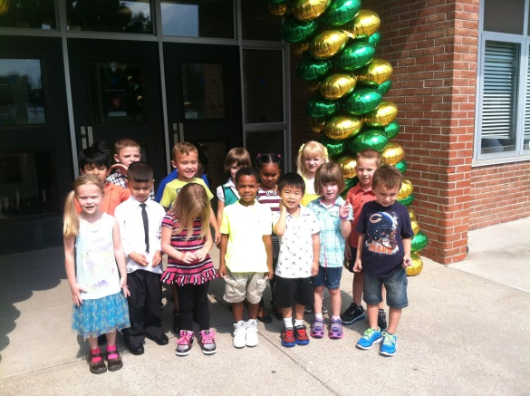
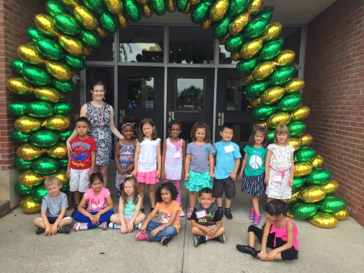
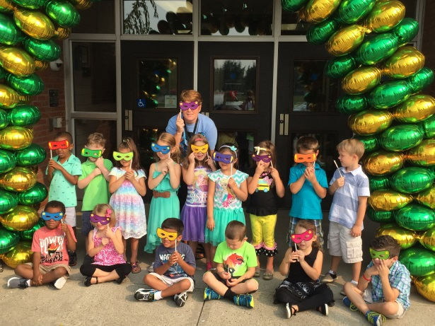
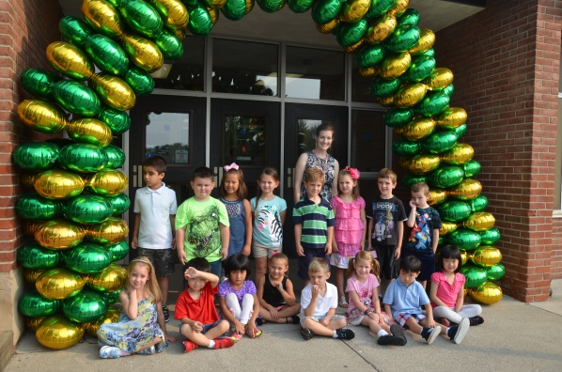
Welcome to Kindergarten!

Slide 2
Fundations Program
Reading
Writing
Reading Strategies
- taking words apart, reading for meaning, and
concrete understanding of letter/sound association
Build a sight word vocabulary
-Dolch Sight Word Lists
Fiction
- Author study, linking picture to words, and answering
questions with evidence from the book
- Genres of Study :Nursery Rhymes, Traditional Tales, Poetry,
Author Studies
Non-Fiction Text
- Identify text structures: table of contents, bold face words,
diagrams, captions, photographs
- identify main idea: What is the author’s purpose?
- determine important information
Letter-Sound association
Letter Formation
Conventions:
- write from left to right, finger spaces,
punctuation, use letter or letters for most consonant and short vowel sounds, match pictures to words
Write independently
The goal for students is to reach an instructional level C by the end of Kindergarten.

Slide 3
Math
Curriculum Topics include:
- Number recognition and
number writing
- Patterns – creating and
extending
- Counting- 1s and 10s, counting on,
counting objects in a group
- Measurement
- Comparing numbers, shapes, and groups –
using math vocabulary
- Shapes – 2D and 3D
- Problem solving
- Addition and Subtraction
facts through 5

Slide 4
Science
Weather (Observations)
Five senses
Match proper clothing and activities with weather
Solids and Liquids
- identify properties of various liquids
- explore sinking and floating
- explain differences between solids and liquids
Living Things - Animals, Plants, and their environment
- what living things need to survive
- observe a seed growing
- sequence the life cycle of a plant

Slide 5
Rules and Regulations
at home, in school, on the playground
Symbols of our Nation
flag, pledge of Allegiance, bald eagle, and Liberty Bell
Holidays of our Nation
Columbus Day, Thanksgiving, Martin Luther King Jr.,
Presidents’ Day
Geography
map skills, globe, land, water
Economics
needs, wants, community helpers, identify coin values
Myself and Others
learn about self, school community, and family
Social Studies

Slide 6
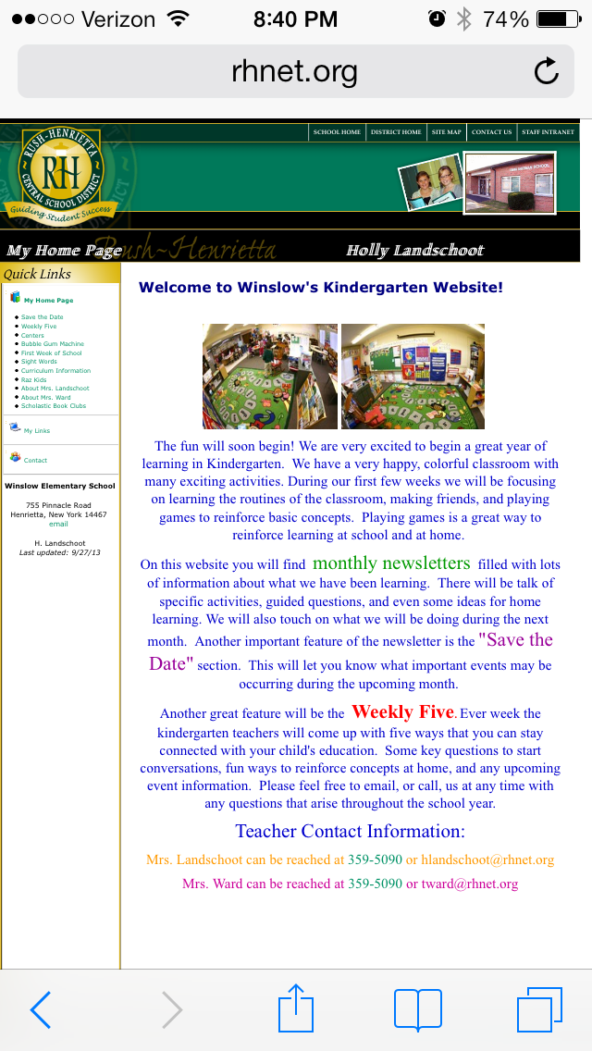
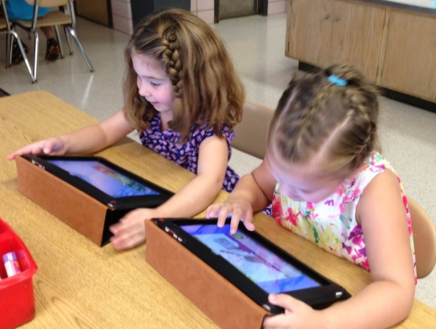
*Web page - Fantastic Five - Save the Date *Technology - Learnpads (2 Class sets to share among the grade level) - 3 Desktops *Specials - Library - P.E.

Slide 7
Don’t Forget:
-Homework -
We send home packets of work or projects for the children to work on each week. Completing these assignments will help your child be more successful at school.
-Parent Teacher Conferences-
We have sent out a link for you to sign up for a time slot to meet with us. Please let us know if you have any questions.
-Volunteers Wanted –
Please send us an email and tell us how you’d like to volunteer in the room:
Read a book to the class, play a game with a small group, work one on one with students…

