Slide 1
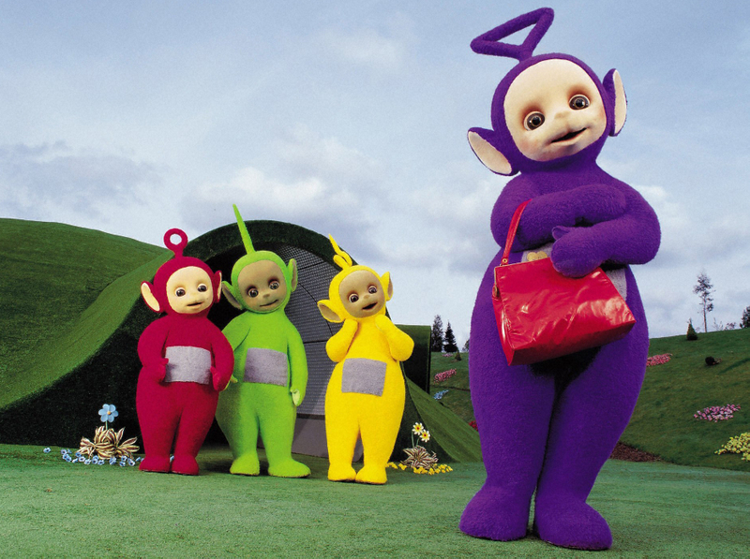
Duped By Children’s Characters
Writing Workshop

Slide 2
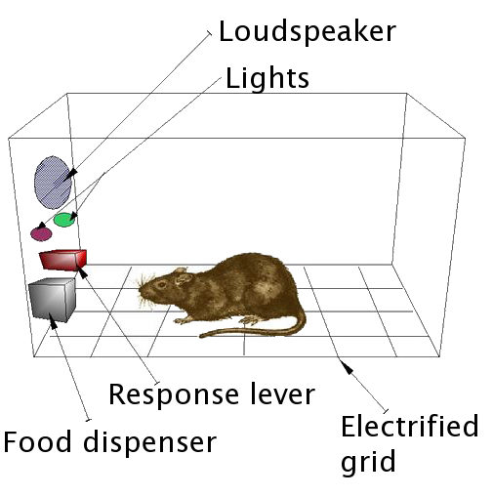
Follow the Pattern to
the Introductory Cheese

Slide 3
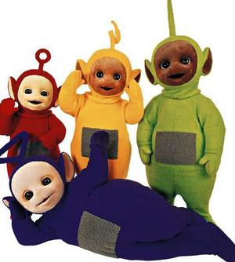
Thesis = Precision + “Big Picture”
In “Duped by Children’s Characters”, Zumwalt complies to Fallwell’s reasoning in a mocking tone to prove just how ridiculous and logically flawed he is. Although a naturalistic fallacy and cum hoc ergo propter hoc are some of the holes in his theory, it’s not until Zumwalt adds further examples that the disconnect is exposed. Her use of ethos not only stomps on his claims but his credibility as a whole.

Slide 4
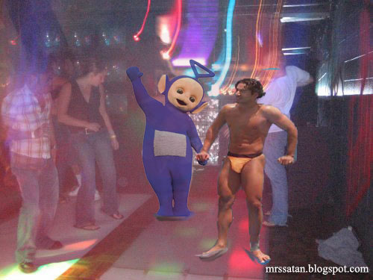
Thesis  Declare or Invert
Sarah Zumwalt’s “Duped by Children’s Characters” lampoons Reverend Jerry Fallwells accusations to dismantle his credibility and the legitimacy of his argument. By using cum hoc ergo propter hoc she displays examples to show that our favorite children’s characters are not corrupt.

Slide 5
Body Paragraphs (GO SYLLOGISTCALLY)
1st Premise = Statement containing a literary term
2nd Premise = Textual Support (Embed Quotes)
Conclusion = Textual Analysis

Slide 6
Student Body Paragraph Sample
Zumwalt establishes her ethos by “duping” the reader into thinking she agrees with the reverend and his conservative message. Instead of putting the article down, the target audience is comforted by the fact that Falwell’s accusations have made “a very enlightening week” for Zumwalt as well as them. This tactical pathos appeals to the readers positively because they are reassured by her ideas and like that she is perhaps one of them. Zumwalt’s diction gives credit to Falwell’s followers, as she says “Now that I understand” and “I see how,” she portrays herself, through thinly veiled sarcasm, to be in compliance with Falwell’s reasoning It creates a false sense of confidence in this unlogical conclusion they have derived. She even goes further to declare that she “had been duped” herself, in an incredibly sarcastic tone. But to those who believe in Fallwell’s theory it comes off sincere. They become sympathetic and understanding because they’ve been fooled all along as well.

Slide 7
Body Paragraph … Go Syllogistically
Subsequent to Reverend Jerry Fallwell’s argument, Sarah Zumwalt intentionally mocks his ideas to show the falsity in his debate. By sarcastically using cum hoc ergo propter hoc she illustrates that it is nearly impossible for these beloved children’s characters to have hidden agendas. Zumwalt substitutes other famous children’s characters into Falwell’s logical framework. She commences with a litany of examples starting with a discussion of Santa Clause being “a communist … the man, dressed in red from head to toe, lives in a large, very cold place in the north – clearly a metaphor for the soviet union. In his ‘shop’, the little people who do all the work appear to control the means of production, but in actuality the big red man has unlimited power.” Sarah Zumwalt then begins … (OVER)

Slide 8
Syllogism Continued
to ridicule “the poor count from Sesame Street who struggles with obsessive compulsive disorder that compels him to count everything in sight, Eeyore is manic depressive, Tweety Bird suffers from paranoia that a putty-tat is watching him and Snoopy had delusions about being a World War I flying ace.” She is spoofing his scheme by saying that because these characters act a certain way, they must be completely shady. Upon concluding her examples, she appeals to the pathos of the reader when asking rhetorical questions such as “what will become of our children?” Clearly she is demonstrating that we don’t really have much to worry about in the media viewed by your offspring.

Slide 9
For the Next Essay …
Avoid the Compositional
“Zaps”

