Slide 1



Slide 2


WHO IS MIKE BERGIN?
President of Chariot Learning
• SAT/ACT tutoring and classes, academic coaching, subject tutoring, and proctored practice tests
Creator of Roots2Words
• Fun yet powerful vocabulary building resource (free WOTD)
Co-host of Tests and the Rest
• THE podcast about testing, admissions, and learning

Slide 3



WHO IS MIKE BERGIN?
President of National Test Prep Association
• Non-profit advocates for the responsible administration and use of tests for admissions and assessment
ACT Certified Educator & Trainer
• Training high school teachers across the U.S. to support College and Career Readiness Standards
Founder of TestBright
• Testing and admissions resource for parents and educators

Slide 4



The SAT & ACT are both standardized college entrance exams administered throughout the school year. They both test substantially the same skills and content.
Colleges accept both equally, but students may score better on one or the other, despite their similarities.

Slide 5

STRUCTURE
SAT
• Completely digital
• Limited scrap paper
ACT
• Mostly paper and pencil
• Expanding digital options

Slide 6
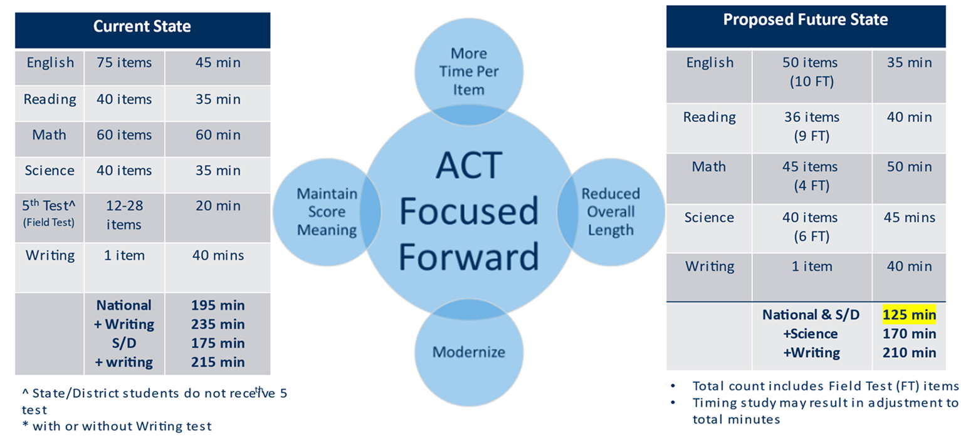
ENHANCED ACT

Slide 7
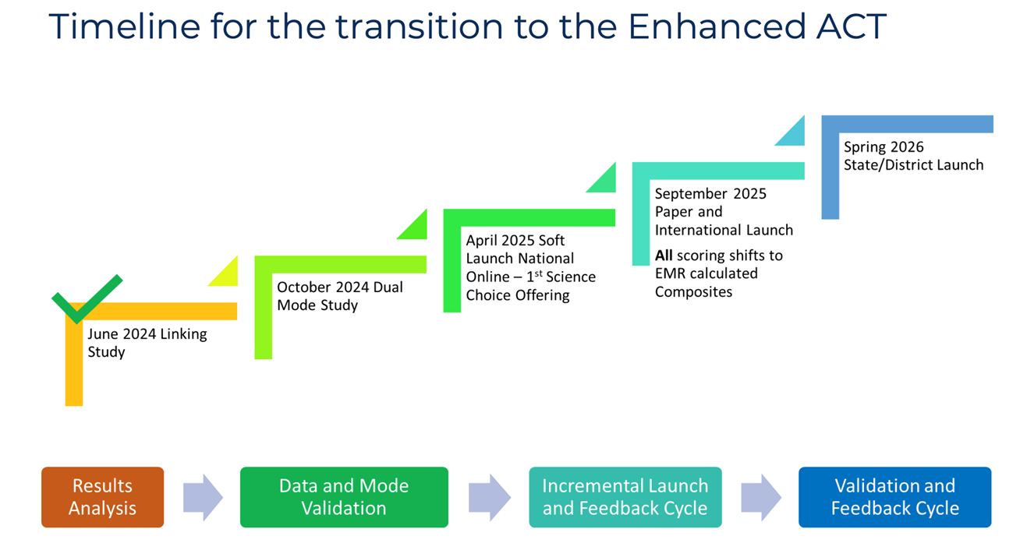
ENHANCED ACT

Slide 8
READING
SAT
• One short passage per question
• Greater emphasis on vocabulary and reasoning
ACT
• One long passage for 10 questions
• Greater emphasis on speed and comprehension

Slide 9
SCIENCE & GRAPHS
SAT
• No dedicated science section
• Science reasoning and graphs tested in RW
ACT
• Full section testing science reasoning
• Emphasis on graphical literacy

Slide 10
GRAMMAR
SAT
• One short passage per question
• Focus on a smaller pool of mechanics
ACT
• One long passage for 14-16 questions
• Broader range of writing skills

Slide 11
MATH
SAT
• Greater emphasis on algebra skills
• More need for problem solving strategies
• Embedded DESMOS calculator
ACT
• Broader range of math skills tested
• More word problems and less graphing

Slide 12
SCORING
SAT
• Section adaptive with a smaller question pool
• Tougher questions count for more than easier ones
ACT
• Linear scoring with a larger question pool
• All questions carry the same weight

Slide 13
SCORE POLICIES
ALL SCORES REQUIRED FOR REVIEW
SCORE CHOICE
• Only send the SAT or ACT scores you want schools to see. Send by test date, not by section.
SUPERSCORE
ACT : Best E + M + R + S
SAT : Best RW + M

Slide 14
WHAT ABOUT TEST OPTIONAL?
ALWAYS CHECK THE CURRENT POLICY.
NOT ALL SCHOOLS ARE SELECTIVE.
TEST OPTIONAL ≠ TEST BLIND.
CONSIDER INSTITUTIONAL PRIORITIES.
ALL FACTORS ARE NOW UNDER SCRUTINY.

Slide 15
PERCENTILES
ACT | SAT | Percentile
36 | 1600 | 99+
34 | 1540 | 99
28 | 1350 | 90
24 | 1200 | 75
19 | 1030 | 50
14 | 870 | 25

Slide 16
OTHER CONSIDERATIONS
SAT
• Shorter test but greater volatility
• No need for a graphing calculator
ACT
• No need for a testing device
• Test Information Release (TIR) 3x a year

Slide 17
HOW DO YOU CHOOSE?
SAT
• More emphasis on critical reasoning, algebra and
problem solving (plus tougher vocabulary)
• Math contributes 50% to total score.
ACT
• More emphasis on long passage speed, science
reasoning, and graphical literacy
• Reading contributes 60-75% to total score.

Slide 18


PSAT & PREACT
WHAT ARE THESE TESTS?
• Shorter versions of related entrance exams
• Good–but not perfect–predictors
• No impact on college admissions
WHY DO THEY MATTER?

Slide 19

WHY DO THEY MATTER?

Slide 20

• College admissions • College readiness
• College scholarship • Submitter advantage

Slide 21
PLANNING
July**
August
September
October
October
November
December
December
February
March
April
May
June
June

Slide 22

QUESTIONS

